Slide 1
To Publish or not to Publish?: A Guide to Securing Publications in the International Journal of Multiple Research Approaches: Perspectives from the Editor-in-Chief
Dr. Tony Onwuegbuzie
Professor, Sam Houston State
Distinguished Visiting Professor, University of Johannesburg
March 7, 2017
Copyright © 2017 by Anthony J. Onwuegbuzie

Slide 2
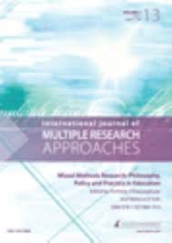
International Journal of Multiple Research Approaches (IJMRA)

Slide 3
History and Evolution of IJMRA
Inception 2007
Onset identical to Journal of Mixed Methods Research
Published by eContent Management Pty Ltd, Maleny OLD 4552, Australia
James H. Davidson, Publishing Director
eContent Management Pty Ltd published articles from Volume 1 (January, 2007) until Volume 8 (December, 2014).

Slide 4
History and Evolution of IJMRA
In 2015, Routledge Taylor and Francis, Taylor and Francis Group took over ownership of IJMRA from eContent Management Pty Ltd
Published Volume 9
Unfortunately, after only 1 year, Routledge Taylor and Francis ceased publication of IJMRA on December 31, 2015, with Volume 9 issue 1 being the final issue published

Slide 5
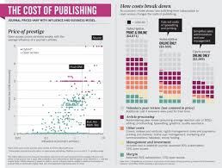
History and Evolution of IJMRA
After much discussion with the Routledge Taylor and Francis Publishers, I was given the opportunity legally to own IJMRA, which I enthusiastically and gratefully accepted.

Slide 6
History and Evolution of IJMRA
After a year (i.e., 2016), in which IJMRA was dormant, as Editor-in-Chief, I am re-launching IJMRA in 2017 with Volume 10, Issue 1.

Slide 7
IJMRA Today…..
Thank you to Professor Anthony Harris, Chair of the Department of Educational Leadership, at Sam Houston State University for part-sponsoring IJMRA

Slide 8
IJMRA Today…..
The following renowned scholars agreed to serve on the editor team in the following capacity:
Co-Editor: Professor R. Burke Johnson (University of South Alabama, USA)
Co-Editor: Dr. John H. Hitchcock (Indiana University, USA)
Co-Editor: Professor Brigitte Smit (University of South Africa, South Africa)
Media Editor: Dr. Vanessa Scherman (University of South Africa, South Africa)
Managing Editor: Dr. Donggil Song (Sam Houston State University, USA)

Slide 9
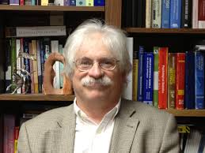
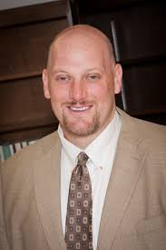
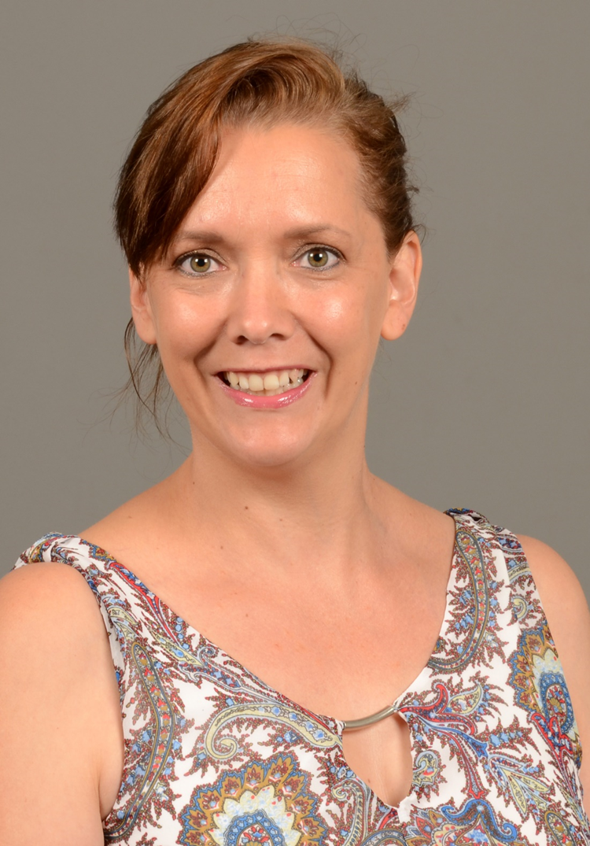
R. Burke Johnson
University of South Alabama, USA
Co-Editor
Tony Onwuegbuzie
Sam Houston State University, USA
Editor-in-Chief
John H. Hitchcock
Indiana University, USA
Co-Editor
Vanessa Scherman
University of South Africa, South Africa
Media Editor
Brigitte Smit
University of South Africa, South Africa
Co-Editor
Donggil Song
Sam Houston State University, USA
Managing Editor

Slide 10
IJMRA Associate Editors
Professor Hester C. Klopper (Deputy Vice Chancellor, University of Stellenbosch, South Africa; University of Western Cape and North-West University, South Africa)
Dr. Charmaine Williamson (Research Fellow, Durban University of Technology, South Africa)
Dr. Prathiba Nateson (University of North Texas, USA)
Dr. Shannon David Misialek (North Dakota State University, USA)
Dr. Mandy Archibald (University of Adelaide, Australia)
Dr. Ann Ooms (Kingston University and St. George’s University of London, England)
Dr. Loraine D. Cook (University of the West Indies, West Indies)
Dr. Hongjing Li (Beijing Foreign Studies University, China)
Dr. Hannah R. Gerber (Sam Houston State University, USA)

Slide 11
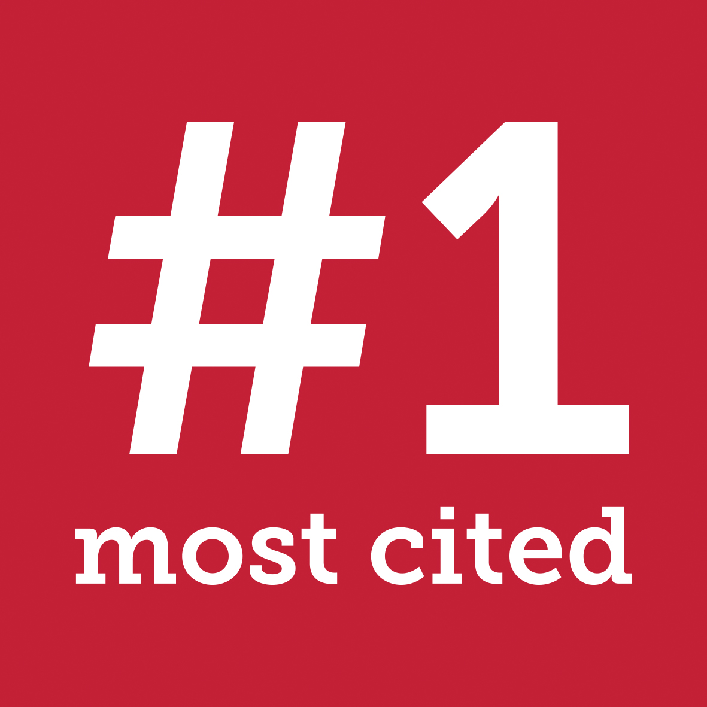
IJMRA: Volume 10, Issue 1
Inaugural Special Issue
Authored by many of the leading mixed methods researchers in the world

Slide 12
IJMRA: Volume 10, Issue 1
Inaugural Special Issue
Will be published as an open access issue within the next few months

Slide 13
IJMRA: Website
The IJMRA website currently is being developed. So, please watch this space……

Slide 14
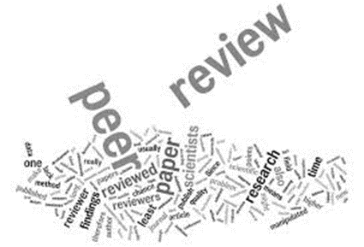
IJMRA: Volume 10, Issue 2
Regular Issue
Quadruple-Blind Review Process
Reviewers not aware of the identity of the authors
Co-Editors not aware of the author identification during the initial review process
Co-Editors not aware of the reviewer identification during the initial review process
Authors not aware of the reviewers

Slide 15
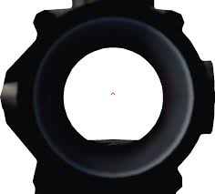
Scope of IJMRA
IJMRA has a wider scope than does JMMR inasmuch as empirical and non-empirical articles in the area of multiple methods research also will be published.
In this webinar, I will focus on the publication of mixed methods research articles.

Slide 16
Publishing in IJMRA
So, what does it take to publish in IJMRA?

Slide 17
IJMRA Definition of Mixed Methods Research (Johnson, Onwuegbuzie, & Turner, 2007)
….Mixed methods research is the research paradigm that (a) partners with the philosophy of pragmatism in one of its forms (left, right, middle); (b) follows the logic of mixed methods research (including the logic of the fundamental principle and any other useful logics imported from qualitative or quantitative research that are helpful for producing defensible and usable research findings); (c) relies on qualitative and quantitative viewpoints, data collection, analysis, and inference techniques combined according to the logic of mixed methods research to address one’s research question(s); and

Slide 18
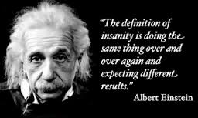
IJMRA Definition of Mixed Methods Research (Johnson, Onwuegbuzie, & Turner, 2007)
….(d) is cognizant, appreciative, and inclusive of local and broader sociopolitical realities, resources, and needs. Furthermore, the mixed methods research paradigm offers an important approach for generating important research questions and providing warranted answers to those questions. This type of research should be used when the nexus of contingencies in a situation, in relation to one’s research question(s), suggests that mixed methods research is likely to provide superior research findings and outcomes.

Slide 19
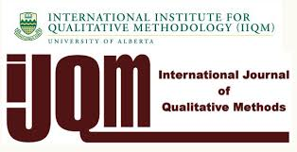
How to Publish in IJMRA
Onwuegbuzie, A. J., & Poth, C. A. N. (2015). Afterword: Special issue. International Journal of Qualitative Methods, 14, 122-125.

Slide 20
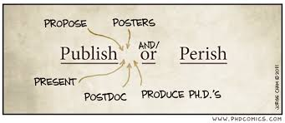
Evidence-Based Mixed Methods Reviewer Sheet
Mixed Methods Case Study of 45 reviews across 16 manuscripts submitted to two International Journal of Qualitative Methods (IJQM) mixed methods research special issues.
Yielded the following six meta-themes:
Warrantedness
Justification
Writing Quality
Transparency
Integration
Philosophical Lens

Slide 21
Warrantedness
For each of the following statements, please indicate the extent to which you agree or disagree, according to the following scale. | 1 Strongly Agree | 2 Disagree | 3 Agree | 4 Strongly Agree | Comment
1.There is adequate support claims and findings made that stem from the extant literature.
2. The findings are presented clearly and adequately.
3. The sources used are both adequate and sufficiently recent.
4. All new or unconventional terms and concepts are adequately defined.
5. Adequate reference is made to the most recent mixed methods research literature
6. The manuscript does not contain any reference list errors
7. The manuscript does not contain any citation error.
Source: Onwuegbuzie & Poth (2016)

Slide 22
Justification
For each of the following statements, please indicate the extent to which you agree or disagree, according to the following scale. | 1 Strongly Agree | 2 Disagree | 3 Agree | 4 Strongly Agree | Comment
8. The manuscript is sufficiently developed.
9. The educational significance is stated clearly.
10. The manuscript adequately advances qualitative/quantitative research.
11. The manuscript adequately advances mixed methods research.
12. Both the rationale of the study and rationale for mixing quantitative and qualitative approaches are stated clearly.
13.The purpose statement is stated clearly
Source: Onwuegbuzie & Poth (2016)

Slide 23
Writing Quality
For each of the following statements, please indicate the extent to which you agree or disagree, according to the following scale. | 1 Strongly Agree | 2 Disagree | 3 Agree | 4 Strongly Agree | Comment
14. The writing style of the manuscript is clear.
15. The manuscript does not contain an inconsistent information.
16. The manuscript contains an appropriate structure.
17. The manuscript does not contain any repetition.
18. The manuscript contains appropriate word usage throughout.
19.The manuscript contains appropriate transitions between sentences and paragraphs.
Source: Onwuegbuzie & Poth (2016)

Slide 24
Transparency
For each of the following statements, please indicate the extent to which you agree or disagree, according to the following scale. | 1 Strongly Agree | 2 Disagree | 3 Agree | 4 Strongly Agree | Comment
20. All the most important procedures are described clearly (if applicable).
21. The sampling design, sampling scheme(s), sample size, and size of all observational units are specified clearly (if applicable).
22. The analysis is described clearly (if applicable).
23. All tables and figure are referred to and explained sufficiently (if applicable).
24. Directions for future research are provided adequately.
25. A clear and substantive conclusion is provided.
Source: Onwuegbuzie & Poth (2016)

Slide 25
Integration
For each of the following statements, please indicate the extent to which you agree or disagree, according to the following scale. | 1 Strongly Agree | 2 Disagree | 3 Agree | 4 Strongly Agree | Comment
26. The mixed methods research framework is presented clearly and adequately
27. Each research question is linked explicitly to the research design used.
28. An appropriate mixed methods research design is used.
29. The application of the manuscript is presented clearly and adequately (if applicable)
30. Discussion of the validity/legitimation issues is presented clearly and adequately.
Source: Onwuegbuzie & Poth (2016)

Slide 26
Philosophical Lens
For each of the following statements, please indicate the extent to which you agree or disagree, according to the following scale. | 1 Strongly Agree | 2 Disagree | 3 Agree | 4 Strongly Agree | Comment
31. All research philosophies that are presented are labelled accurately and adequately.
32. The research philosophy used by the researcher/author is specified and described clearly and accurately.
Source: Onwuegbuzie & Poth (2016)

Slide 27
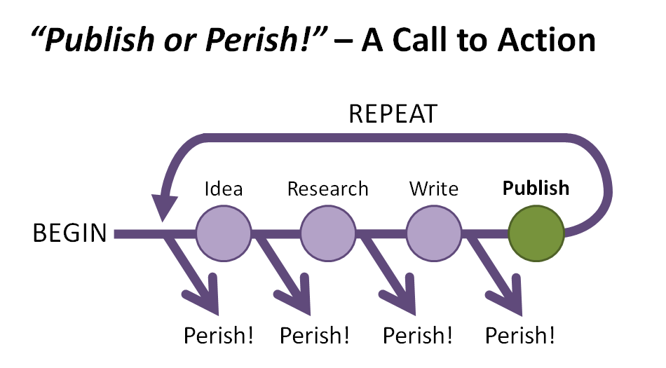
Evidence-Based Mixed Methods Guidelines
Onwuegbuzie, A. J., & Corrigan, J. A. (2014). Improving the quality of mixed research reports in the field of human resource development and beyond: A call for rigor as an ethical practice. Human Resource Development Quarterly, 25, 273-299. doi:10.1002/hrdq.21197
Wisdom, J. P., Cavaleri, M. A., Onwuegbuzie, A. J., & Green, C. A. (2012). Methodological reporting in qualitative, quantitative, and mixed methods health services research articles. Health Services Research Journal, 47, 721-745. doi:10.1111/j.1475-6773.2011.01344.x

Slide 28
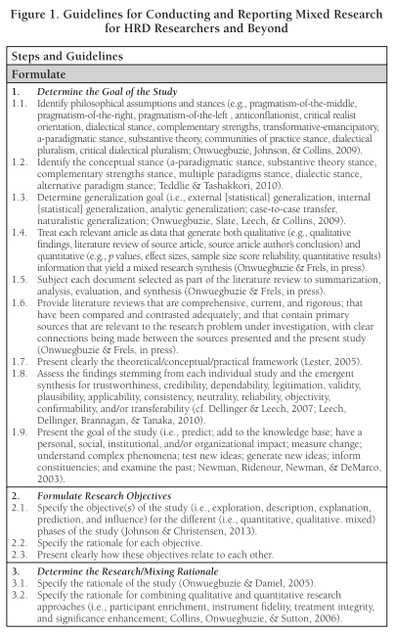
Source: Onwuegbuzie, A. J., & Corrigan, J. A. (2014). Improving the quality of mixed research reports in the field of human resource development and beyond: A call for rigor as an ethical practice. Human Resource Development Quarterly, 25, 273-299. doi:10.1002/hrdq.21197
Notes:
Here’s an outline of all the steps in the Formulate phase, and specifically for Step 1, Determine the Goal of the Study.
At the beginning of your booklets, you will see our Guidelines for conducting and reporting mixed research broken down in 4 phases through 13 steps.
Today, we will have a look at all of those guidelines, though due to time constraints, we are going to spend more time on the ones where rigour typically breaks down the most, as people like Tony have seen in his study on errors commonly made in reporting research in the journal Research in the Schools.

Slide 29
Evidence-Based Articles on Writing With Discipline
Link to Article on APA Errors
Blog Article on APA Errors
Link to Article on Conceptual Errors
Link to Article on Abstracts
Link to Article on Creating Tables
Link to Article on Number of Citations
Link to Article on Citation Errors
Link to Article on Reference List Errors
Link to Article on Readability
Link to Article on Using Verbs
Link to Article on Link Words/Phrases
29

Slide 31
No | APA Error Code | % | Description of Error and Reference to Fifth Edition APA Rule Page No. | Description of Error and Reference to Sixth Edition APA Rule Page No.
1 | Numbers | 57.3% | Not using figures (e.g., all numbers 10 and above; p. 122); not using numbers to represent time, dates, ages, sample, subsample, or population size or in a numbered series (pp. 124-125) | No change in the rule, with the exceptions that (a) do not use figures for sample size, population size, or specific numbers of subjects or participants in an experiment; (b) use words for approximations of numbers of days, months, and years; and (c) do not use numerals for numbers below 10 that are grouped with numbers above 10 (p. 112)
2 | Hyphenation | 55.5% | Not hyphenating a compound with a participle when it precedes the term it modifies (p. 91) | No change in the rule (p. 97)
3 | Use of et al. | 44.5% | Not citing all authors the first time; in subsequent citations, not including only the surname of the first author followed by "et al." (not italicized and with a period after “al”; p. 208) | Clarifications were provided for citing works by six or more authors (p. 175)

Slide 32
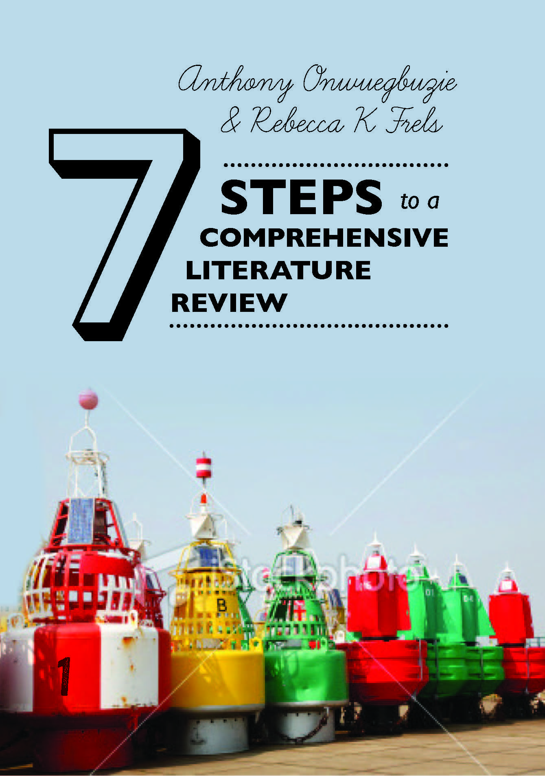

Slide 33
Happy Writing!!!!!

Slide 34
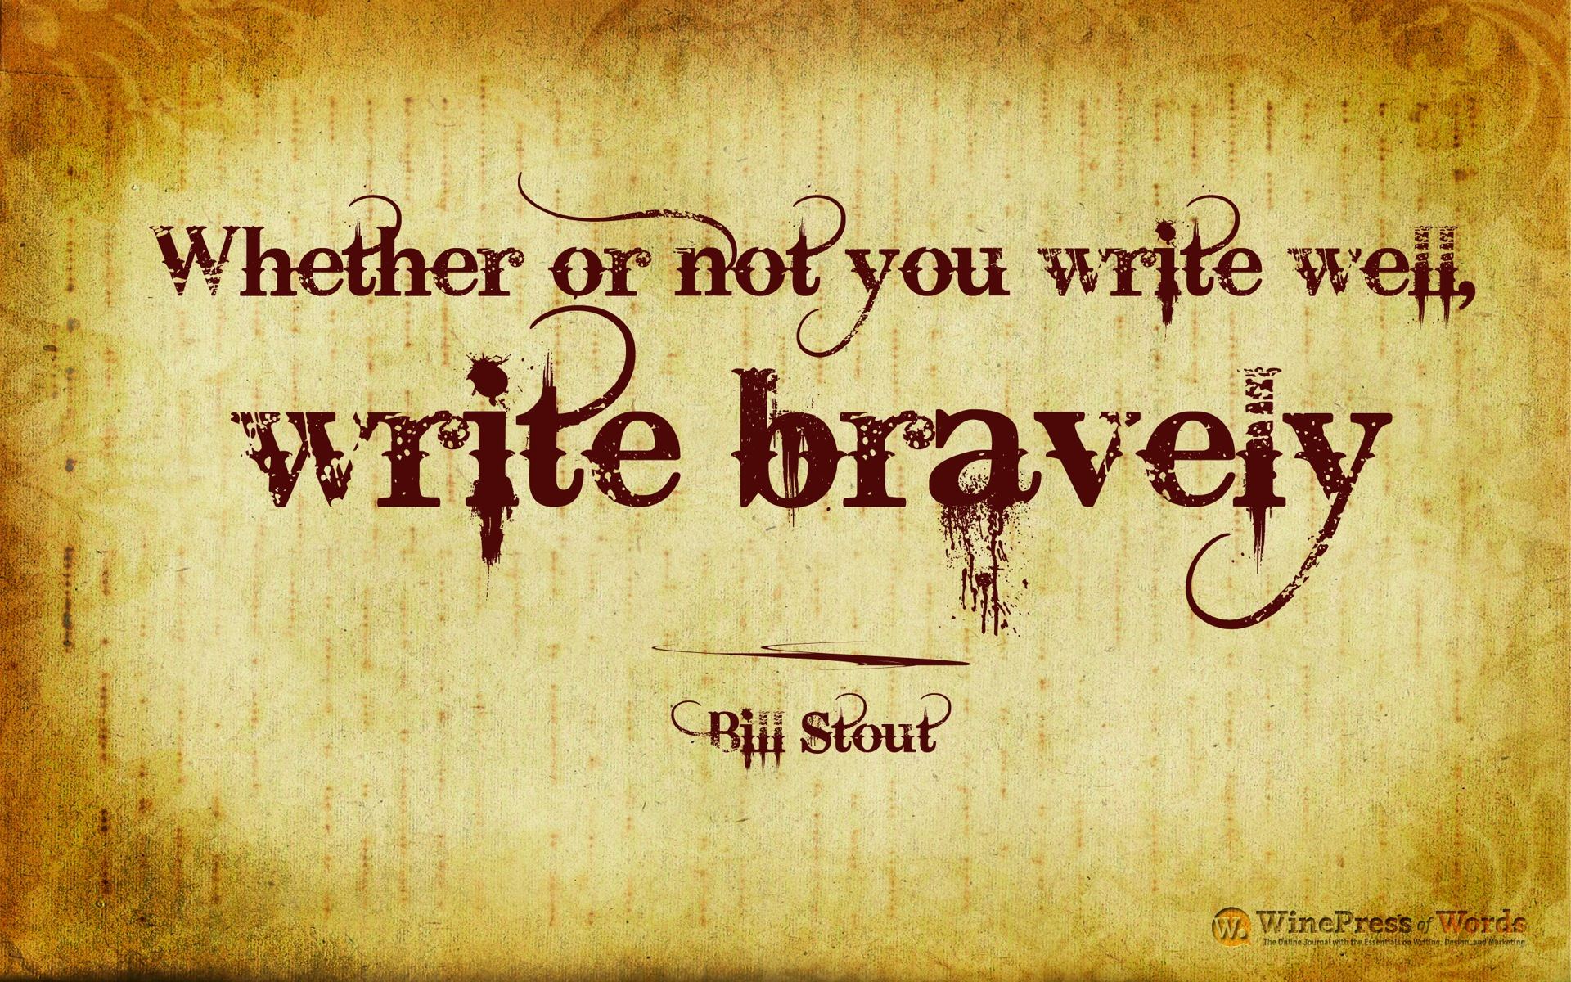
.

Slide 35
If you have further questions you would like to follow up with me, I can be contacted at:
tonyonwuegbuzie@aol.com

