Slide 1
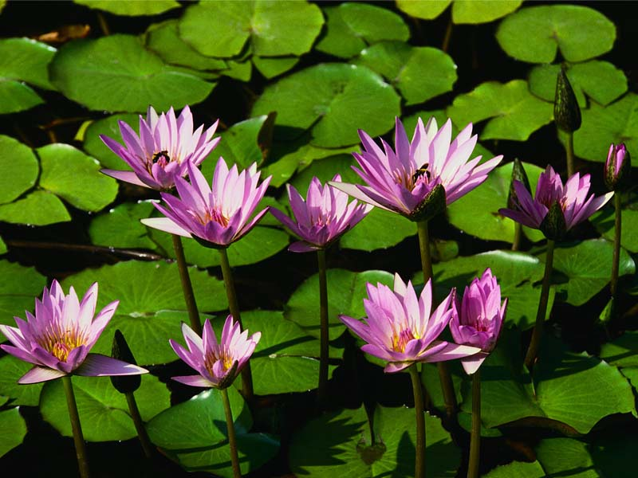
Saving the Earth

Slide 2
We Can Now Recycle
Newsprint
Bottles
Regular Paper
Aluminum Cans

Slide 3
Reduce Waste
Biodegradable dishes used in lunchroom
Compost heap in south parking lot
Carpool sign up sheet
Give your car a tune-up!

Slide 4
Doing Your Part
GREEN BUCKS
$5
GUARANTEED

Slide 5
Questions And Answers
Does recycled paper save trees?
Can recycled paper be recycled?
Does recycled paper have to be bleached?

