Slide 1
Global Holidays
Annual General Meeting 2017

Slide 2
November 24-26, 2017
Rundle Roost Lodge and Conference Centre
Banff, Alberta, Canada

Slide 3
Mission Statement
Adventures in the great
outdoors…Naturally!

Slide 4
AGM Agenda
The Beginning of Global Holidays
History of a Successful Business
2016 — A Tremendous Year
Prosperity for 2017
Past Growth and Performance
2018 — Forecasts

Slide 5
Customer Promotions
Summer Holiday Draw
Winter Holiday Draw

Slide 6
Business Prospects
Adventure Tours
  Cycling Tours
  Ecological Holidays
  Whitewater Rafting
Bus Tours
  Includes Europass
  Continental Breakfast
Sightseeing Tours

Slide 7
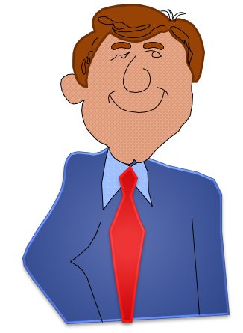
How It All Started
There are many business opportunities in the great outdoors
Roger Gustavson,
President

Slide 8
Organizational Structure
Roger Gustavson, President
Jennifer Fletcher
Executive Assistant
Bill Johnston
Manager, MIS
Emile Lamoureux
Secretary Treasurer
Mark Billington
Vice President, Operations
Carol Hurtig
Vice President, Sales and Marketing

Slide 9
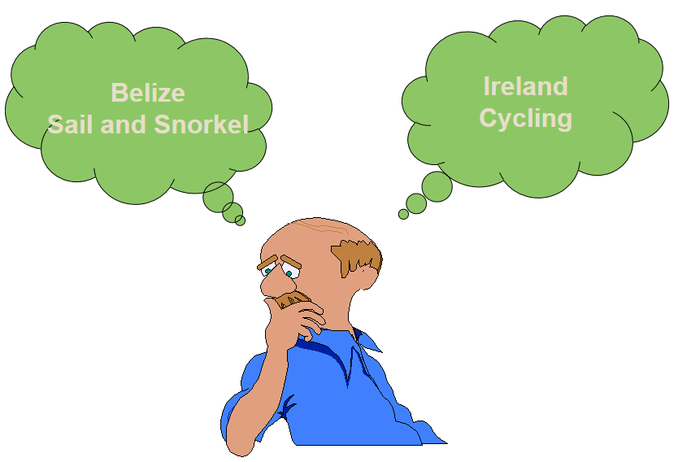
New Adventures for 2018

