Slide 1
This Year’s Personal Vacation Specials
FUN!
As a way of thanking us for our business, Global Business Travel is offering all employees of Worldshop Imports the following tour-package specials.

Slide 2

Morocco
GLOBAL
Business Travel
Casablanca
Rabat
Tangier
Marrakech
Fez
Oujda

Slide 3
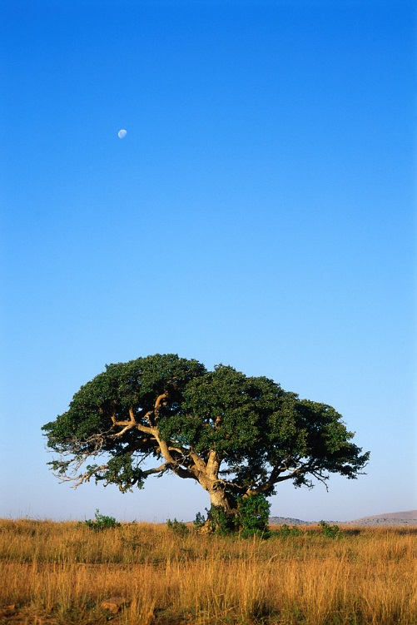
South Africa
GLOBAL
Business Travel
Johannesburg
Pretoria
Bloemfontein
Richards Bay
Cape Town
De Aar

Slide 4
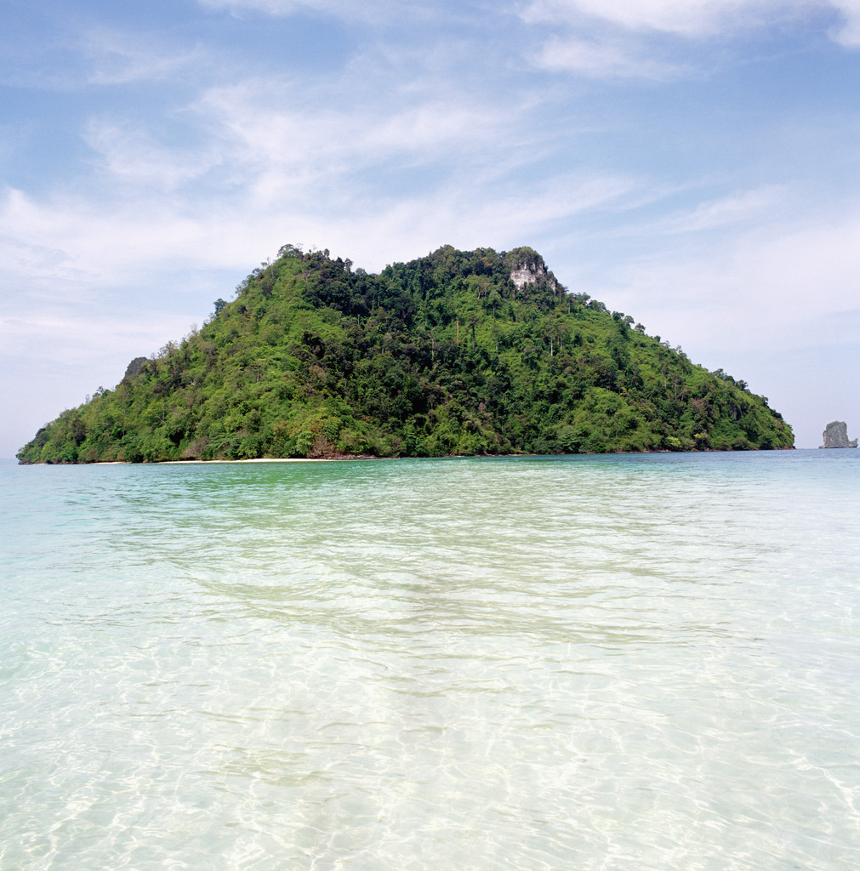
Thailand
GLOBAL
Business Travel
Bangkok
Si Racha
Surat Thani
Phuket
Songkla
Pattani

Slide 5
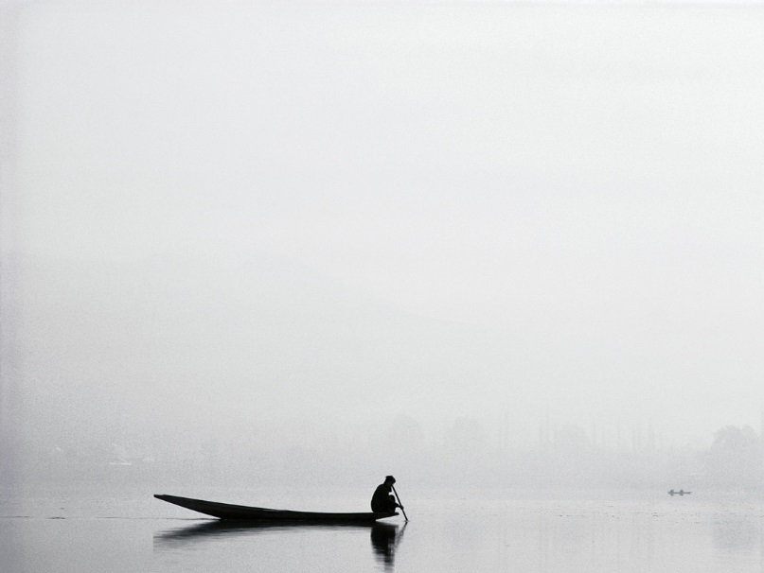
India
GLOBAL
Business Travel
New Delhi
Agra
Kanpur
Calcutta
Chennai
Mumbai

Slide 6

Prices & Seasons Available
Morocco
$800
Spring
South Africa
$1000
Summer
Thailand
$800
Fall
India
$1000
Winter
Prices include all transportation and accommodations

Slide 7
“Just our way of saying thank you for your business.”
-- Jerry Pym, President
Global Business Travel
Prices include all transportation, accommodations, and tour packages per person, per week.
For more information, contact Linda Wu in Purchasing.

