Slide 1
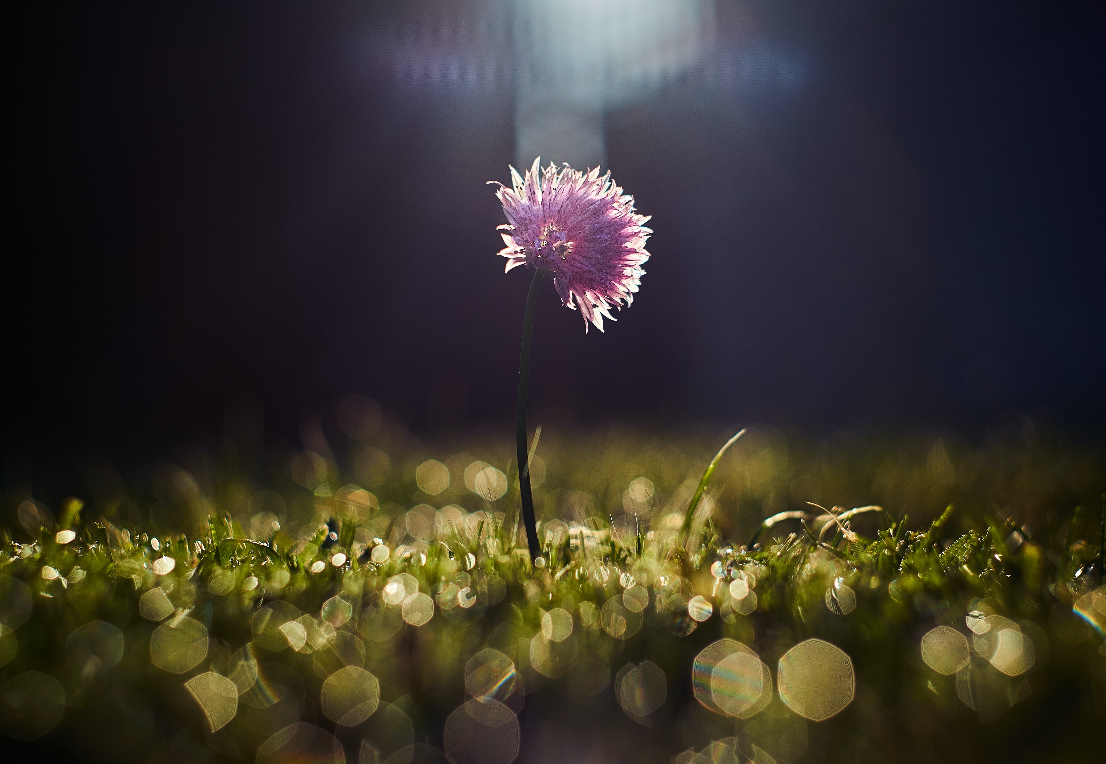
RESILIENCY STRATEGIES DURING A PANDEMIC
Rebecca Low, RN, BScN, MEd (HSE)
Faculty of Nursing

Slide 2
Objectives
Background: Why Resiliency is Relevant to Nursing and this Pandemic
What Resiliency is (Characteristics & Influences)
Research-Based Strategies
Questions & Comments

Slide 3
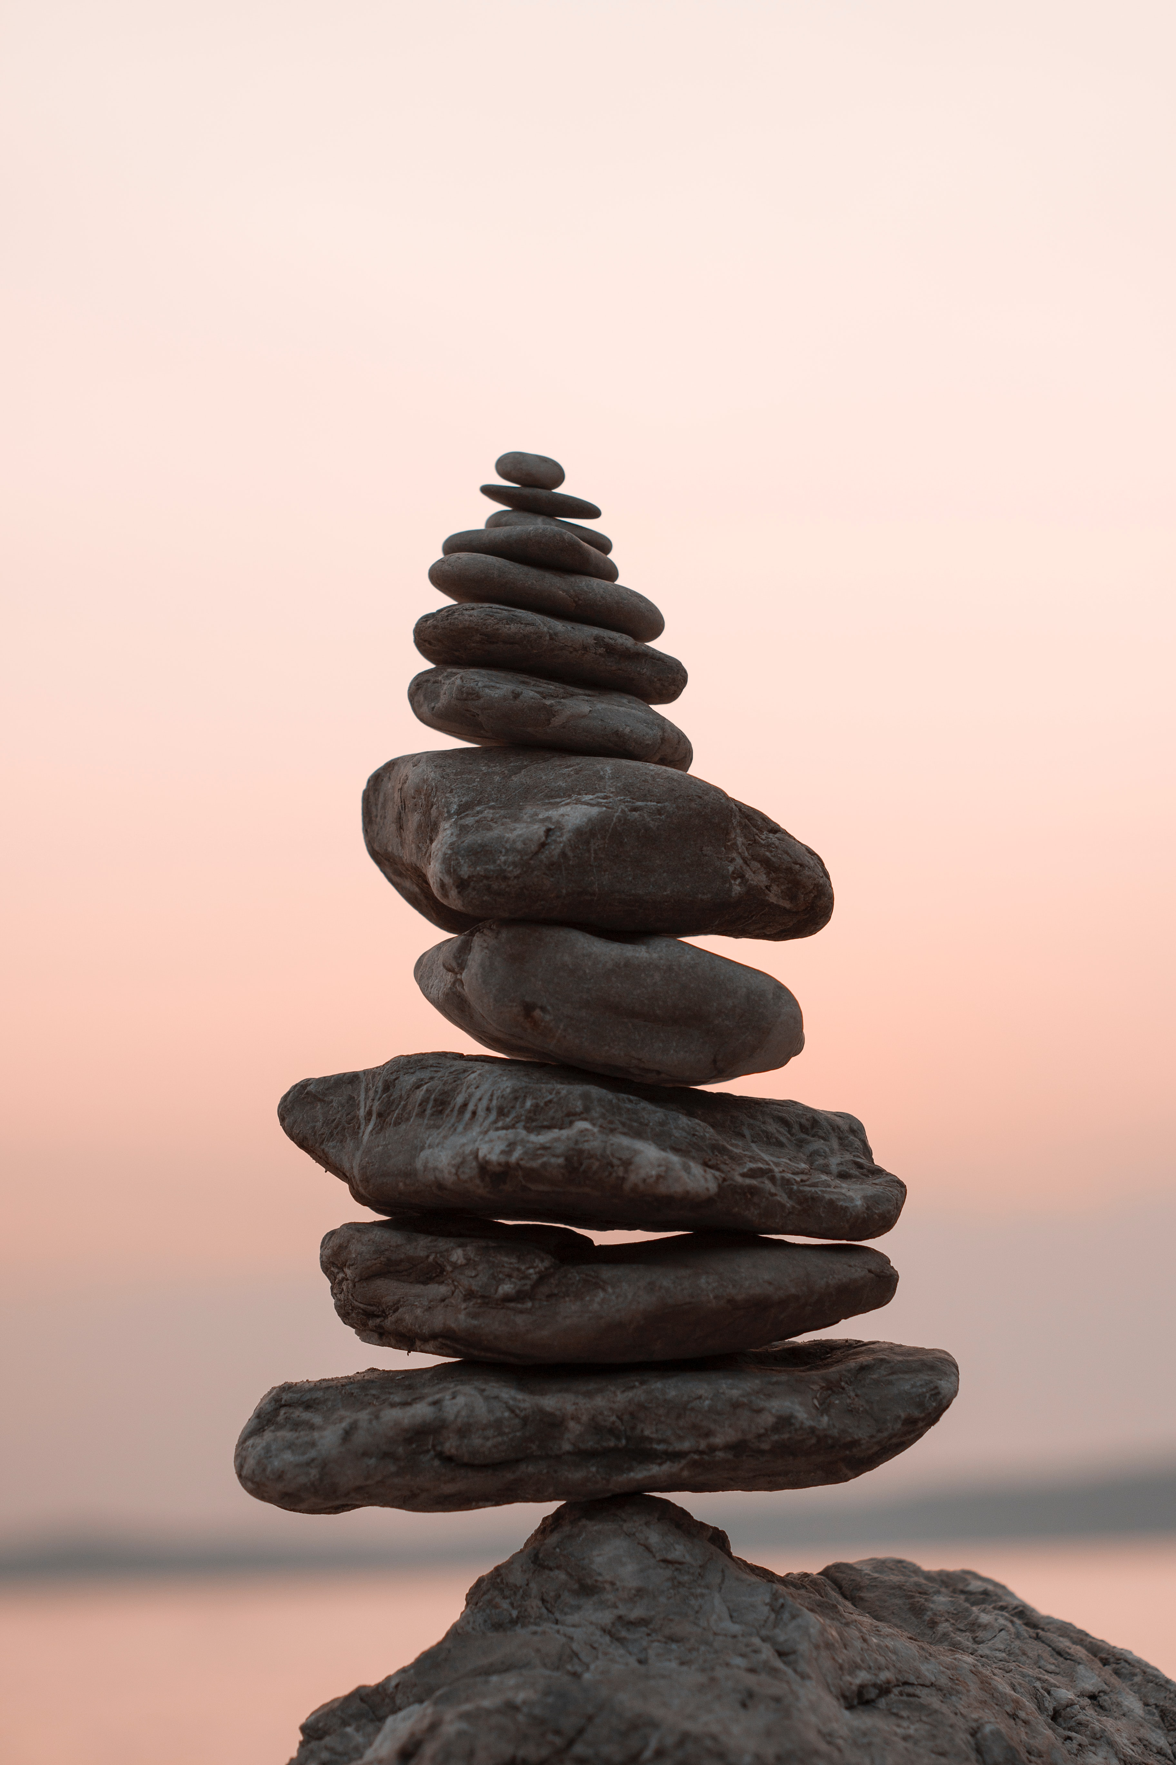
Why are we Discussing Resiliency?
We know…
Stress is inevitable
If left unmanaged, stress can have significant negative impacts on health, well-being & performance
We need positive coping skills & personal resilience in order to overcome adversities

Slide 4

How is this Relevant Now?
As the pandemic unfolds, there is no greater opportunity to demonstrate and develop resilience

Slide 5
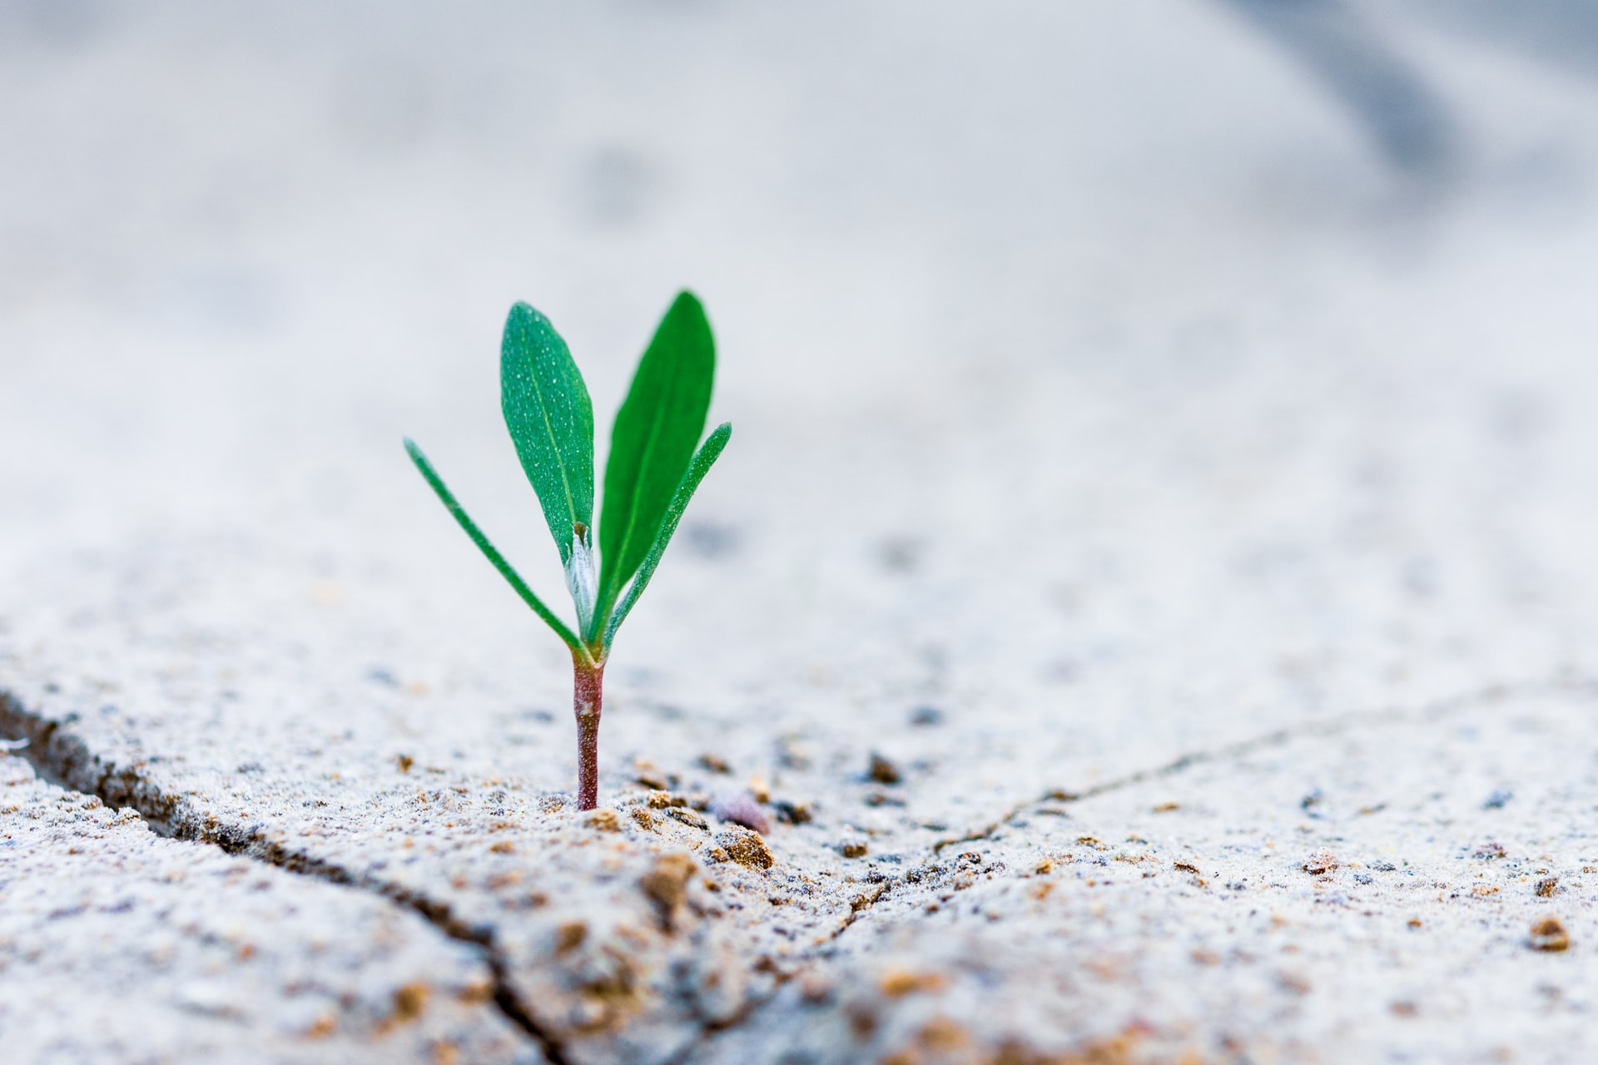
What is Resiliency?
Resilience is the presence of positive coping skills during adverse experiences and the ability to self-regulate and move forward in a constructive manner following challenging situations

Slide 6
Characteristics & Influences
Intrapersonal Characteristics:
Disposition of control
Altruism
Responsiveness
Self-confidence
Positivity & Humour
Environmental Influences:
Peer & Social Support
Sense of Belonging

Slide 7

Research-Based Strategies
This is a journey…

Slide 8
Reflective Practice
3 Approaches to Reflective Practice associated with Developing Resiliency:
Written Reflection
Strength-Based Reflection
Group Reflection

Slide 9


Written Reflection
Writing creates new perspectives, insights & provides the opportunity to explore positive approaches and cultivate self-awareness.
Activities:
Reflect on challenges to find positive approaches
Write on wellness themes (guided questions)
Develop resiliency plan

Slide 10

Strength-Based Reflection
Focusing on solutions and strengths rather than issues and failures promotes transformative growth & resilience through enabling individuals to overcome difficulties, move forward and establish a professional identity.
Activities:
Identify team strengths and discuss solutions based on applying those strengths
Identify previously used coping skills and apply those same strategies to your practice now
Identify & use your personal strengths

Slide 11


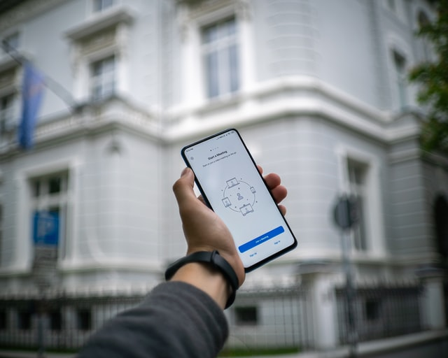
Group Reflection
Increases confidence and resilience through sharing a sense of connection and belonging with colleagues. Offering & receiving peer support has reciprocal benefits.
Activity:
Create opportunities for new ways to connect, debrief, and share learning experiences, stress management & coping techniques and resources

Slide 12

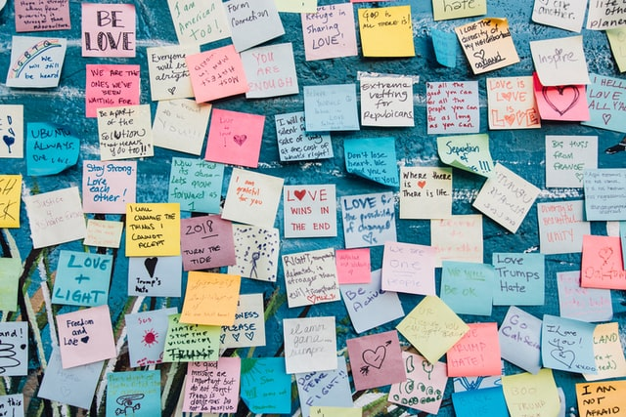

Professional Identity & Values
Having a professional identity & values helps develop a passion for work and contributes to a sense of belonging to a professional family.
Activities:
Identity your professional values
Return to your reason, remember & know your why

Slide 13
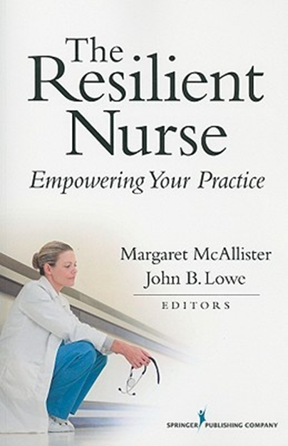
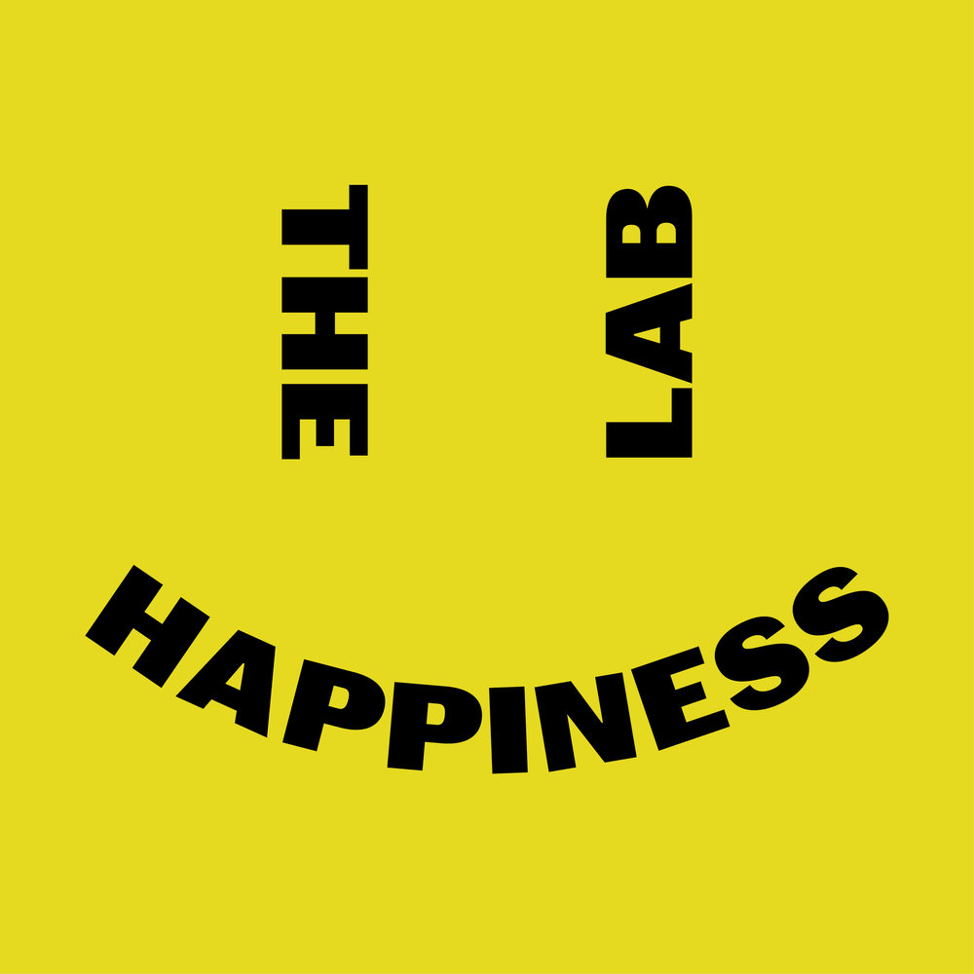
Stories of Resiliency
Stories have an incredible power to inspire and transform us, we can learn from others acquisition of resiliency.
Activities:
Look for inspiration from others, read stories of resilience
Listen to Podcasts about resilience
Consider what your own story of this time will be

Slide 14
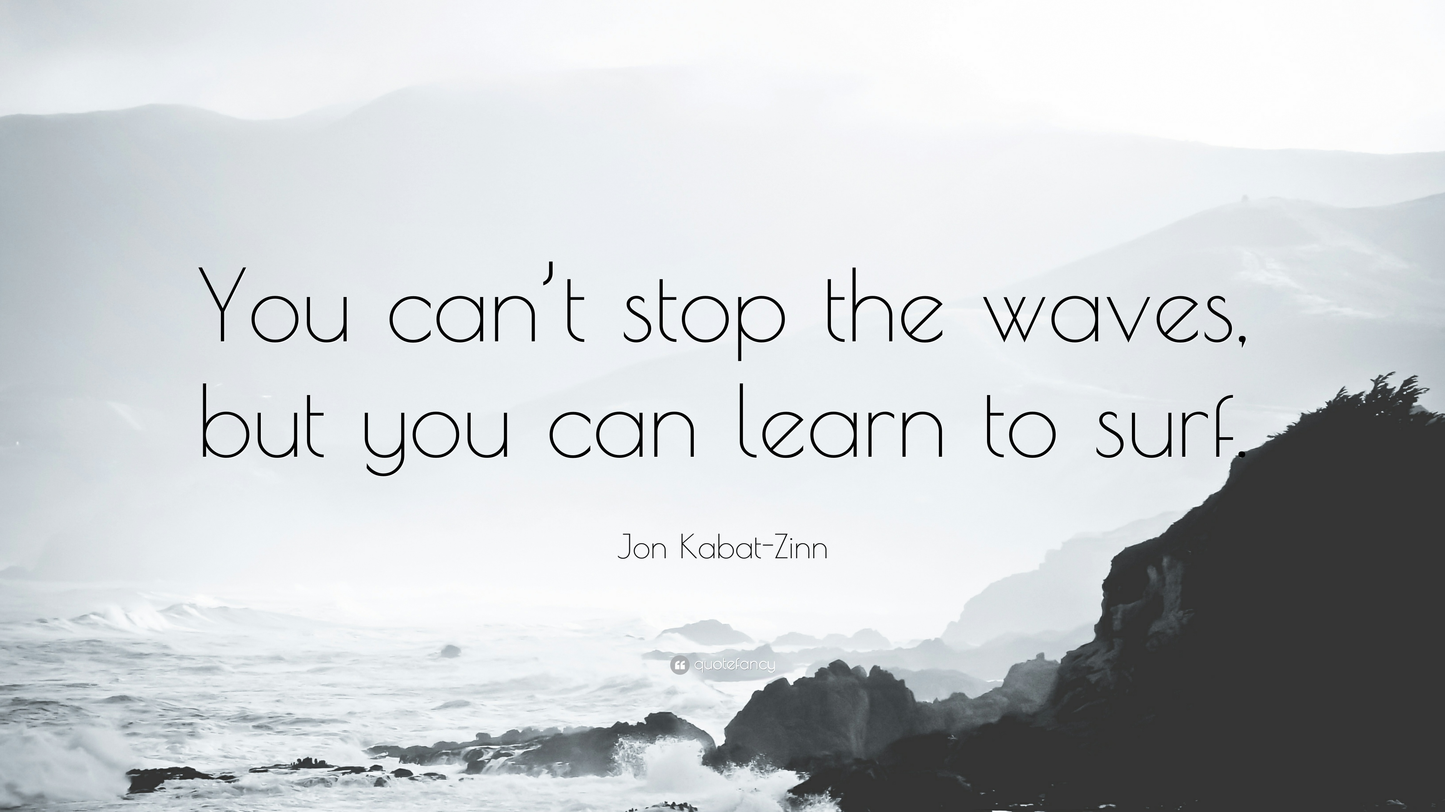
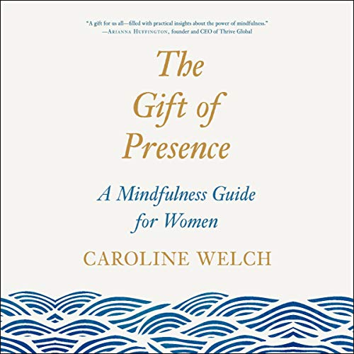
Mindfulness & Meditation Practice
Enhances stress resilience, relational skills, information processing, self-awareness, emotional intelligence, cultivating compassion for self & others and responding to loss & grief.
Activities:
Practicing an attitude of acceptance for things beyond your control
Apply the 3 P’s in your life (Purpose, Pivoting & Pacing)

Slide 15
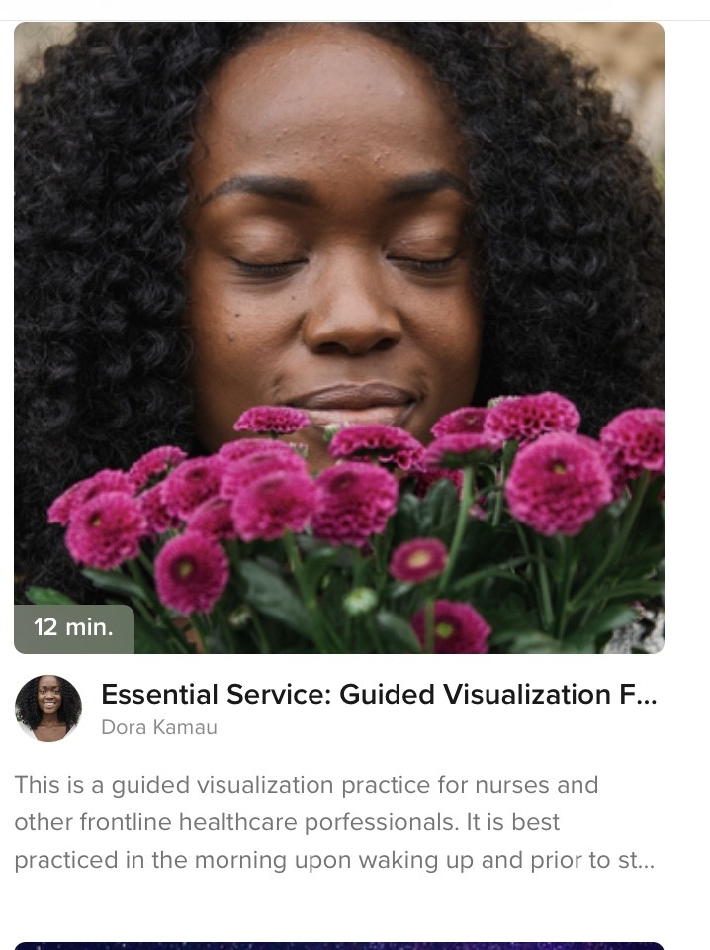
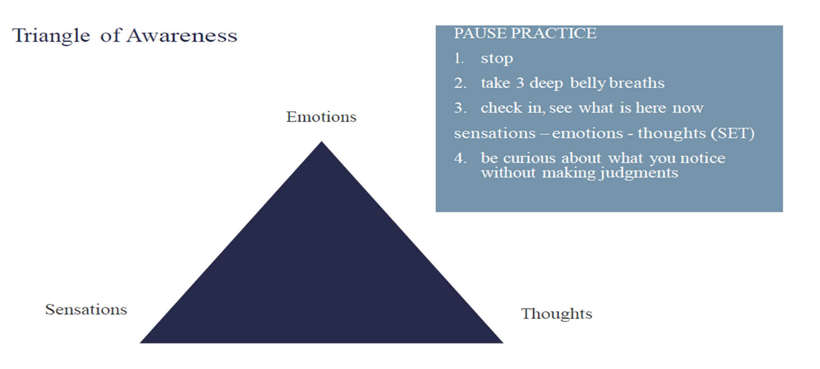
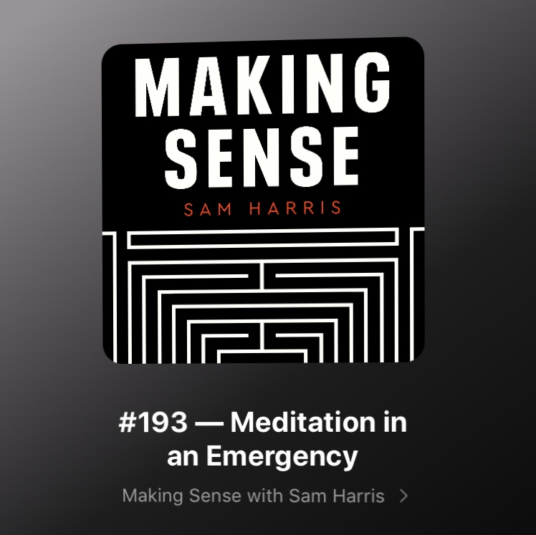
Mindfulness & Meditation Practice
Activities:
Identify stress-triggers, use Pause Practice when you notice stress arising
Guided practices available online, many free apps & podcasts

Slide 16
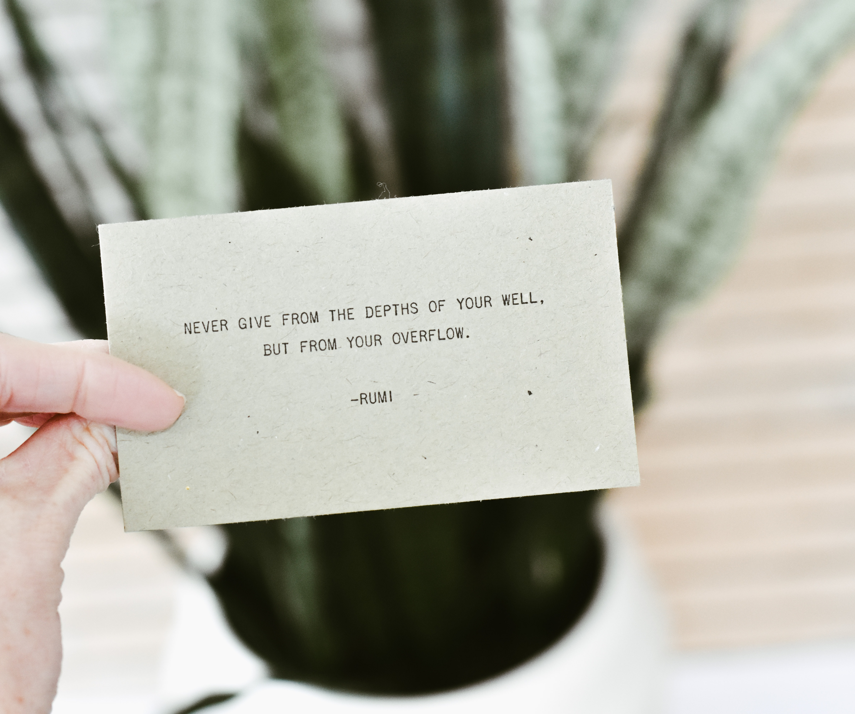
Self-Care
Key component for developing and maintaining resilience. Self-care is highly individualized & involves any activity that you find restorative and allows you to reconnect with yourself or others.
Activities:
Complete a self-assessment and develop a self-care plan

Slide 17
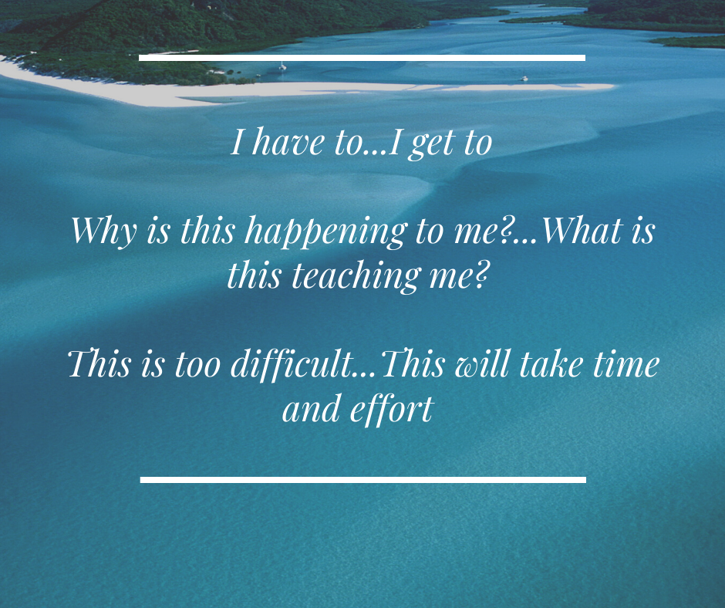
Reframing Stress
An active coping strategy to manage stress and build resilience that involves creating and using positive statements to transform perception of an issue.
Activity:
Pay attention to your thoughts & the way you speak, see if you can start to identify negative pattens and reframe & transform negative statements
Access practices that discuss reframing and affirmations if you need guidance on how to start

Slide 18

Summary
This is a process and a journey. Start with incorporating strategies that resonate with you most, reflect on what you need right now & see if you can build any of these strategies into your routine. Go day by day, reach out to your supports, and use the resources that speak to your needs.

Slide 19

PAUSE
BREATH
NOTICE

Slide 20
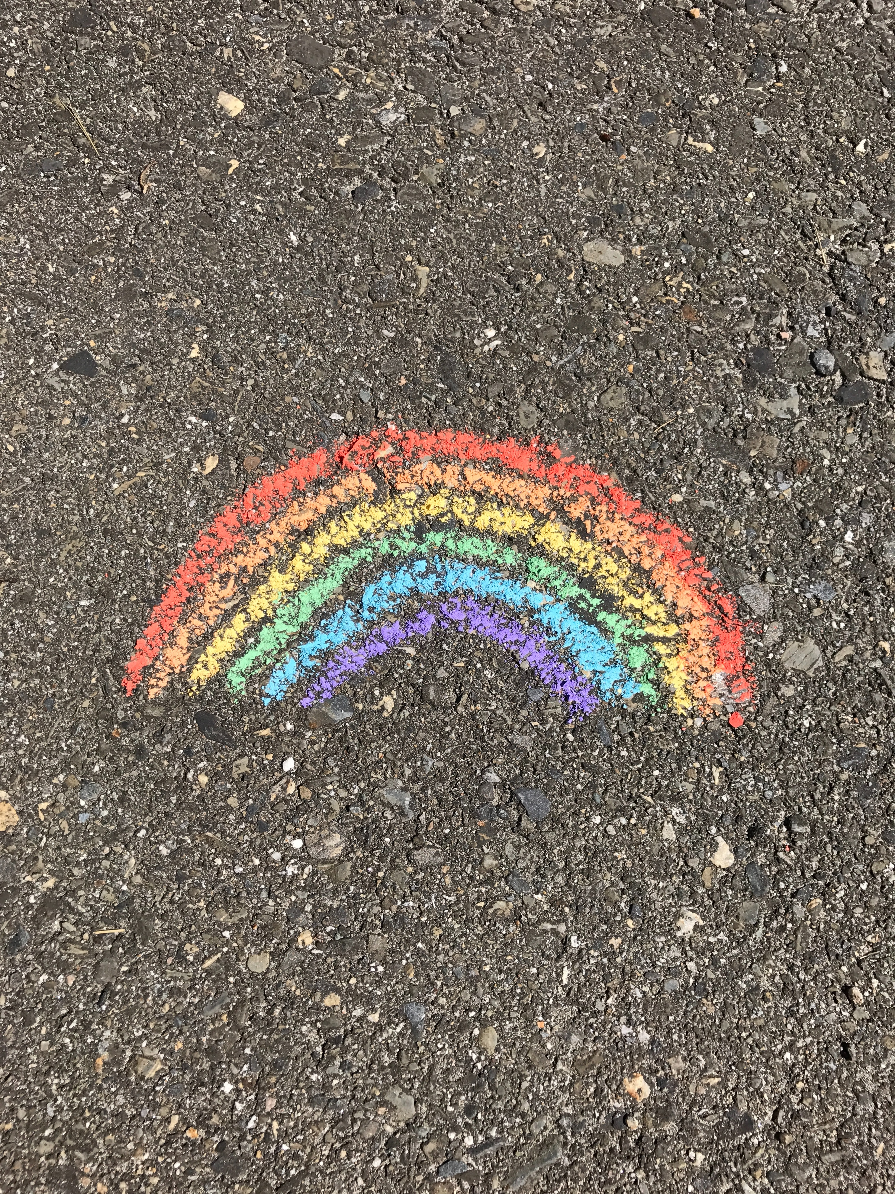
Questions & Comments

Slide 21
References
Bass, J., Walters, C., Toohill, J., & Sidebotham, M. (2016). Promoting retention, enabling success: Discovering the potential of student support circles. Nurse Education in Practice. doi: 10.1016/j.nepr.2016.07.002
Beddoe, L., Davys, A., & Adamson, C. (2013). Educating resilient practitioners. Social Work Education, 32(1), 100-117. http://dx.doi.org/10.1080/02615479.2011.644532
Delany, C., Miller, K. J., El-Ansary, D., Remedios, L., Hosseini, A., & McLeod, S. (2015). Replacing stressful challenges with positive coping strategies: a resilience program for clinical placement learning. Advances in Health Sciences Education, 20, 1303-1324. doi: 10.1007/s10459-015-9603-3
Grant, L. & Kinman, G. (Eds.). (2014). Developing resilience for social work practice. London, UK: Palgrave.
Hodges, H. F., Keeley, A. C., & Grier, E. C. (2005). Professional resilience, practice longevity, and Parse’s Theory for baccalaureate education. Journal of Nursing Education, 44(12), 548-554. Retrieved from http://eds.b.ebscohost.com.login.ezproxy.library.ualberta.ca/eds/pdfviewer/pdfviewer?sid=fded61be-7938-4234-a19e-4fa0bd86036d%40sessionmgr101&vid=1&hid=114
Hunter, B., & Warren, L. (2014). Midwives’ experiences of workplace resilience. Midwifery, 30, 926-934. http://dx.doi.org/10.1016/j.midw.2014.03.010
Jackson, D., Firtko, A., & Edenborough, M. (2007). Personal resilience as a strategy for surviving and thriving in the face of workplace adversity: A literature review. Journal of Advanced Nursing, 60(1), 1-9. doi: 10.1111/j.1365-2648.2007.04412.x
Jha, A. As cited by Hurley, D. (2014, Jan,14). Breathing in vs. spacing out. The New York Times Magazine. https://www.nytimes.com/2014/01/19/magazine/breathing-in-vs-spacing-out.html?_r=0
Kinman, G., McMurray, I., & Williams, J. (2014).Enhancing self-knowledge, coping skills and stress resistance. In L., Grant, & G., Kinman (Eds.), Developing resilience for social work practice (148-168). London, UK: Palgrave.

Slide 22
References
Kreitzer, M. J., & Klatt, M. (2017). Educational innovations to foster resilience in the health professions. Medical Teacher, 39(2), 153-159. doi: 10.1080/0142159X.2016.1248917
Leroux, M., & Theoret, M. (2014). Intriguing empirical relations between teachers’ resilience and reflection on practice. Reflective Practice, 15(3), 289-303. doi: 10.1080/14623943.2014.900009
McAllister, M., & Lowe, J. B. (Eds.). (2011). The resilient nurse: empowering your practice. New York, NY: Springer Publishing Company.
McAllister, M., & McKinnon, J. (2009). The importance of teaching and learning resilience in the health disciplines: A critical review of the literature. Nurse Education Today, 29, 371-379. doi: 10.1016/j.nedt.2008.10.011
McDermid, F., Peters, K., Daly, J., & Jackson, D. (2016). Developing resilience: Stories from novice nurse academics. Nurse Education Today, 38, 29-35. http://dx.doi.org/10.1016/j.nedt.2016.01.002
McDonald, G., Jackson, D., Vickers, M. H., & Wilkes, L. (2016). Surviving workplace adversity: A qualitative study of nurses and midwives and their strategies to increase personal resilience. Journal of Nursing Management, 24, 123-131. doi: 10.1111/jonm.12293
McDonald, G., Jackson, D., Wilkes, L., & Vickers, M. H. (2013). Personal resilience in nurses and midwives: Effects of a work-based educational intervention. Contemporary Nurse, 45(1), 134-143. Retrieved from http://eds.a.ebscohost.com.login.ezproxy. library.ualberta.ca/eds/pdfviewer/pdfviewer?sid=c9c5ce0c-7620-42a1-80ed-c439c69c661c%40sessionmgr4008&vid=1&hid=4105
Meyer, K. M., Licklider, B. L., & Wiersema, J. A. (2009). My life in a bag and other stories: On the road to resiliency. Journal of Scholarship of Teaching and Learning, 9(1), 118-133. Retrieved from http://eric.ed.gov.login.ezproxy.library.ualberta.ca/?id=EJ854883

Slide 23
References
Ng, W., & Nicholas, H. (2015). iResilience of science pre-service teachers through digital storytelling. Australian Journal of Educational Technology, 31(6), 736-751. Retrieved from http://eds.a.ebscohost.com.login.ezproxy.library.ualberta.ca/ eds/pdfviewer/pdfviewer?sid=8672230e-0c52-4e18-8828 4b2964bd1508%40sessionmgr4006&vid=3&hid=4105
Parkes, R., & Kelly, S. (2014). Mindfulness for resilience in social work. In L., Grant, & G., Kinman, (Eds.), Developing resilience for social work practice (110-127). London, UK: Palgrave.
Pines, E. W., Rauschhuber, M. L., Cook, J. D., Norgan, G. H., Canchola, L., Richardson, C., & Jones, M. E. (2014). Enhancing resilience, empowerment, and conflict management among baccalaureate students. Nurse Educator, 39(2), 85-90. doi:10.1097/NNE.0000000000000023
Santos, L., & Gendler, T. (2015). Knowing is half the battle. In Brockman, J. (Eds.), This idea must die: scientific theories that are blocking progress (312-314). New York, NY: HarperCollins Publishers.
Seligman, M. (2004). The new era of positive psychology [video file]. Retrieved from https://www.ted.com/talks/martin_seligman_the_new_era_of_positive_psychology?language=en#t-2283
Serwint, J. R., Bostwick, S., Burke, A. E., Church, A., Gogo, A., Hofkosh, D., King, M., Linebarger, J., McCabe, M. E., Moon, M., Osta, A., Rana, D. T., Sahler, O. J., Smith, K., Rivera, F., & Baldwin, C. (2016). The AAP resilience in the face of grief and loss curriculum. Pediatrics, 138(5), 1-9. doi: 10.1542/peds.2016-0791
Skovholt, T. M., & Trotter-Mathison, M. (2011). The resilient practitioner: Burnout prevention and self-care strategies for counselors, therapists, teachers, and health professionals (2nd ed.). New York, NY: Routledge Taylor and Francis Group.
Stallman, H. M. (2011). Embedding resilience within the tertiary curriculum: a feasibility study. Higher Education Research & Development, 30(2), 121-133. doi: 10.1080/07294360.2010.509763

Slide 24
References
Steinhardt, M., & Dolbier, C. (2008). Evaluation of a resilience intervention to enhance coping strategies and protective factors and decrease symptomatology. Journal of American College Health, 56(4), 445-453.
Tait, M. (2008). Resilience as a contributor to novice teacher success, commitment, and retention. Teacher Education Quarterly, 35(4), 57-75. http://www.jstor.org/stable/23479174
Tusaie, K., & Dyer, J. (2004). Resilience: A historical review of the construct. Holistic Nursing Practice, 18(1), 3-8. Retrieved from http://eds.b.ebscohost.com.login.ezproxy.library.ualberta.ca/eds/pdfviewer/pdfviewer?sid=8de2aa81-62cd-47ea-b6bf00883bc0bca3%40sessionmgr107&vid=3&hid=114
Wald, H. S., Haramati, A., Bachner, Y. G., & Urkin, J. (2016). Promoting resiliency for interprofessional faculty and senior medical students: Outcomes of a workshop using mind-body medicine and interactive reflective writing. Medical Teacher, 38(5), 525-528. doi: 10.3109/0142159X.2016.1150980
Wald, H. S., Anthony, D., Hutchinson, T. A., Liben, S., Smilovitch, M., & Donato, A. A. (2015). Professional identity formation in medical education for humanistic, resilient physicians: Pedagogic strategies for bridging theory to practice. Academic Medicine, 90(6), 753-760. doi: 10.1097/ACM.0000000000000725
Wald, H. S., Reis, S. P., Monroe, A. D., & Borkan, J. M. (2010). ‘The loss of my elderly patient:’ Interactive reflective writing to support medical students’ rites of passage. Medical Teacher, 32, 178-184. doi: 10.3109/01421591003657477
Welch, C. (2020). The gift of presence: a mindfulness guide for women. London, UK: Scribe Publications.
Wilks, S. E., & Spivey, C. A. (2010). Resilience in undergraduate social work students: Social support and adjustment to academic stress. Social Work Education, 29(3), 276-288.doi: 10.1080/02615470902912243

