Slide 1
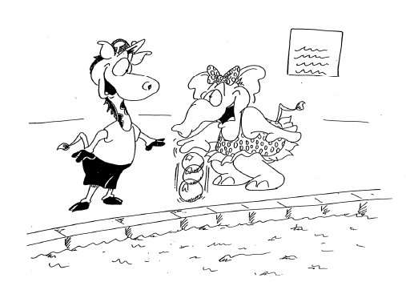
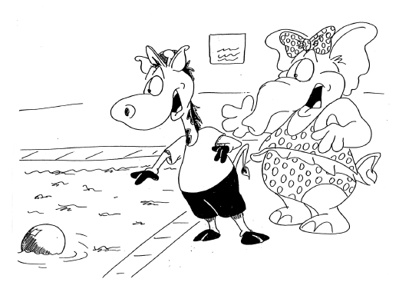
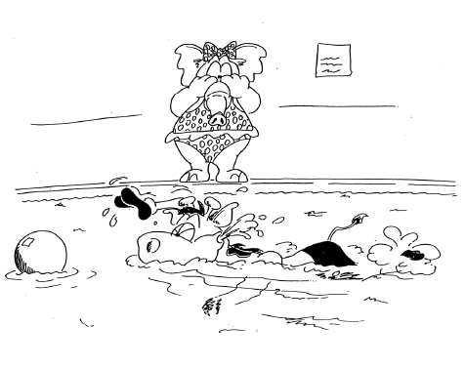
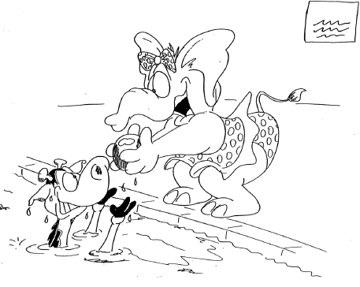
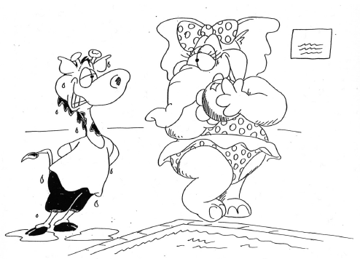
How well do complex sentence measures differentiate children with and without language impairment?
Evidence from a narrative generation task
Ling-Yu Guo (lingyugu@buffalo.edu), Phyllis Schneider*, Alyssa Cavallari, & Kerry Steed
University at Buffalo, University of Alberta*
Standardized tests: Why are they not enough?
Complex sentences: How do we measure them?
Procedure & Analysis
Results
Why are standardized tests not enough in language assessment?
Standardized language tests typically evaluate what children know but not what they do with this knowledge in real-life situations (Constanza-Smith, 2010).
In a review of 43 standardized tests, Spaulding et al. (2006) found that the majority of the tests had unacceptably low diagnostic accuracy (i.e., <80%) or did not report diagnostic accuracy data in the manual.
If the clinician applies an arbitrary cutoff score (e.g., 1.25SD below the mean), a child who is truly affected by language impairment has an approximately equal chance of being correctly or incorrectly identified.
What can clinicians do to improve the identification of children with LI? Use language samples!
Some language sample measures demonstrate acceptable or better diagnostic accuracy for children at different ages across studies.
Productive of tense usage: 2;0 – 3;11
Accuracy of tense usage: 3;0 – 6;11
Percent grammatical utterances: 3;0 – 8;11
Despite that children with language impairment (LI) are more limited in using complex sentences (Scott, 2014) than children with typical language (TL), the diagnostic accuracy of complex sentences has yet to be determined.
Three ways of measuring the use of complex sentences:
1) Subordination index (SI; Miller et al., 2011)
2) Nonfinite index (NI)
3) Complexity Index (CI)
An example of computation:
([I] = independent, [F] = finite, [N] = nonfinite)
Narrative sample collection and processing
A narrative sample was collected from each child using six sets of pictures (Schneider et al., 2006).
(http://www.rehabmed.ualberta.ca/spa/enni)
Utterances were segmented into C-units (i.e., an independent clause plus any number of dependent clauses; fragments that express complete thoughts).
Only C-units that had at least a verb were included.
Summary of background and narrative measures
Group differences in complex sentence measures
Subordination Index: TL > LI (for all three age groups)
Nonfinite Index: TL > LI (for 4- and 8-year-olds only)
Complexity Index: TL > LI (for all three age groups)
Diagnostic accuracy of complex sentence measures
Total # of Independent + finite dependent clauses
Total # of C-units that have at least a verb
Total # of nonfinite dependent clauses
 | Sensitivity | Specificity | LR+ | LR-
Four-Year-Olds
Subordination Index (cut-off = 1.03) | 83% | 73% | 3.14 | 0.23
Nonfinite Index (cut-off =) | 67% | 86% | 4.76 | 0.39
Complexity Index (cut-off = 1.09) | 75% | 94% | 12.25 | 0.27
Six-Year-Olds
Subordination Index (cut-off = 1.08) | 73% | 62% | 1.91 | 0.44
Nonfinite Index (cut-off =) | 45% | 78% | 2.07 | 0.70
Complexity Index (cut-off = 1.18) | 55% | 86% | 3.90 | 0.53
Eight-Year-Olds
Subordination Index (cut-off = 1.10) | 71% | 86% | 5.04 | 0.34
Nonfinite Index (cut-off =) | 59% | 88% | 4.90 | 0.47
Complexity Index (cut-off = 1.34) | 88% | 72% | 3.15 | 0.16
Total # of C-units that have at least a verb
Total # of Independent + finite/nonfinite dependent clauses
Total # of C-units that have at least a verb
C There was a boy and a girl [I] who were friends [F].
C When they played [F], the ball dropped [I].
C The boy tried hard to get [N] the ball [I].
C The girl was happy [I].
C The end. (no verb, not included for analysis)
 | Age | CELF-P/-3 | # of C-units | MLCU-m
4-Year-Olds
TL (n = 50) | 55 (3) | 107.67 (12.13) | 68.65 (19.57) | 6.98 (0.97)
LI (n = 12) | 55 (4) | 76.83 (8.62) | 60.25 (20.84) | 5.15 (1.33)
6-Year-Olds
TL (n = 50) | 78 (3) | 107.36 (19.93) | 71.96 (19.16) | 7.61 (0.97)
LI (n = 11) | 79 (3) | 78.70 (8.34) | 75.36 (25.24) | 6.92 (1.04)
8-Year-Olds
TL (n = 50) | 103 (3) | 107.50 (12.94) | 77.80 (21.22) | 8.74 (1.06)
LI (n = 17) | 104 (3) | 76.29 (11.94) | 74.43 (22.61) | 7.22 (0.87)
Note: Red = acceptable or better (i.e., sensitivity/specificity > 80%, LR+ > 5.00, LR < 0.20)
Subordination Index = 6/4 = 1.5
Nonfinite Index = 1/4 = 0.25
Complexity Index = 7/4 = 1.75
Concluding Thoughts
Despite that children with LI were more limited in using complex sentences, the diagnostic accuracy of complex sentence measures was unacceptably low across three age groups.
Clinical implications
The present study does not support the use of complex sentence measures for identification purposes.
However, the indices of complex sentences (e.g., SI, NI, CI) can be used to track the development of, or the treatment progress of, complex sentences.
Children with LI start to show limited use of complex sentences as young as age 4. Thus, intervention of complex sentences should start at the preschool ages.
Complex sentences: What are they?
Research Questions
Note: Age in months; MLCU-m: mean length of C-units in morphemes
A complex sentence is an independent clause plus one or more dependent clauses.
Finite dependent clauses (Subordinate clauses)
Adverbial clauses: After she lost it, he was really mad.
Nominal clauses: She thought the plane was cool.
Relative clauses: He used the net that was by the pool.
Nonfinite dependent clauses
Infinitive clauses: She wanted to ask for help.
Bare infinitive clauses: He helped her get the ball.
Gerund clauses: She made a mistake by dropping it.
Present participle clauses: She saw him walking.
Past participle clauses: The wagon had a flag tied to it.
Did children with typical language (TL) and children with language impairment (LI) differ in the complex sentence measures (i.e., SI, NI, CI) across ages?
Did the complex sentence measures have at least acceptable diagnostic accuracy across ages?
Results
Were there group differences of complex sentence measures? Yes.
 | SI | NI | CI
4-Year-Olds
TL (n = 50) | 1.07 (0.16) | 0.15 (0.06) | 1.22 (0.18)
LI (n = 12) | 0.78 (0.30) | 0.10 (0.09) | 0.87 (0.34)
6-Year-Olds
TL (n = 50) | 1.10 (0.07) | 0.18 (0.05) | 1.28 (0.98)
LI (n = 11) | 1.00 (0.16) | 0.15 (0.06) | 1.15 (0.18)
8-Year-Olds
TL (n = 50) | 1.18 (0.09) | 0.23 (0.07) | 1.41 (0.12)
LI (n = 17) | 1.08 (0.07) | 0.17 (0.06) | 1.26 (0.11)
Participants
Acknowledgement, Disclosure, & References
Participants were 62 four-year-olds (50 TL, 12 LI), 61 six-year-olds (50 TL, 11 LI), 67 eight-year-olds (50 TL, 17 LI)
All children were mainstream English-speaking
All children passed screenings for cognition, hearing, articulation, oral mechanism (Schneider et al., 2006).
Acknowledgement & Disclosure:
This project was supported by Blackwell Language Research Grant award to the first author and a research grant from the Children’s Health Foundation of Northern Alberta awarded to the second author. We thank Amy Briggs, Katelynn Imagna, Kayla Kuehlewind, and Sanjana Nair for data coding.
Ling-Yu Guo: No conflict of interest; Phyllis Schneider: The author of ENNI, but has no financial relationship with ENNI
Alyssa Cavallari: No conflict of interest; Kerry Steed: No conflict of interest
Selected References
Schneider, P., Hayward, D., & Dubé, R. V. (2006). Storytelling from pictures using the Edmonton narrative norms instrument. Journal of Speech Language Pathology and Audiology, 30(4), 224-238.
Scott, C. M. (2014). One size does not fit all: Improving clinical practice in older children and adolescents with language and learning disorders. Language, Speech, and Hearing Services in Schools, 45(2), 145-152
(Note: SI = Subordination Index; NI = Nonfinite Index; CI = Complexity Index)

