Slide 1
ePortfolios: Pharm Communications 314/334
Pharm 314
Lisa Guirguis, PhD
3-225 ECHA
GOAL: To reflect on lab simulations as part of professional development and create a repository of learning.

Slide 2
Why Reflect?
formal reflection by health professionals increased diagnostic accuracy (K.V. Mann, 2008) and reduced in medical errors (Wald & Reis, 2010).
Source:
http://guides.library.ualberta.ca/content.php?pid=157535&sid=1333738

Slide 3
Why Reflect?
Insanity: doing the same thing over and over again and expecting different results.
Misattributed to various people, including Albert Einstein and Mark Twain. The earliest known occurrence, and probable origin is Rita Mae Brown, Sudden Death (Bantam Books, New York, 1983), p. 68.
"We learn not from doing, but by thinking about what we do.” - Unknown source.

Slide 4
How to Reflect?
This is a simple model which poses the questions ‘What? So what? And Now what?’
What – describe the situation; achievements, consequences, responses, feelings, and problems.
So what – discuss what has been learnt; learning about self, relationships, models, attitudes, cultures, actions, thoughts, understanding, and improvements.
Now what – identify what needs to be done in order to; improve future outcomes, and develop learning
It is believed that the third and final stage is of the greatest importance in contributing to practice Rolfe et al (2001).
Rolfe et al (2001) Framework

Slide 5
“Ten years of experience without reflection is just one year experience repeated ten times.”
(Arseneasu & Rodenburg, 1998)

Slide 6
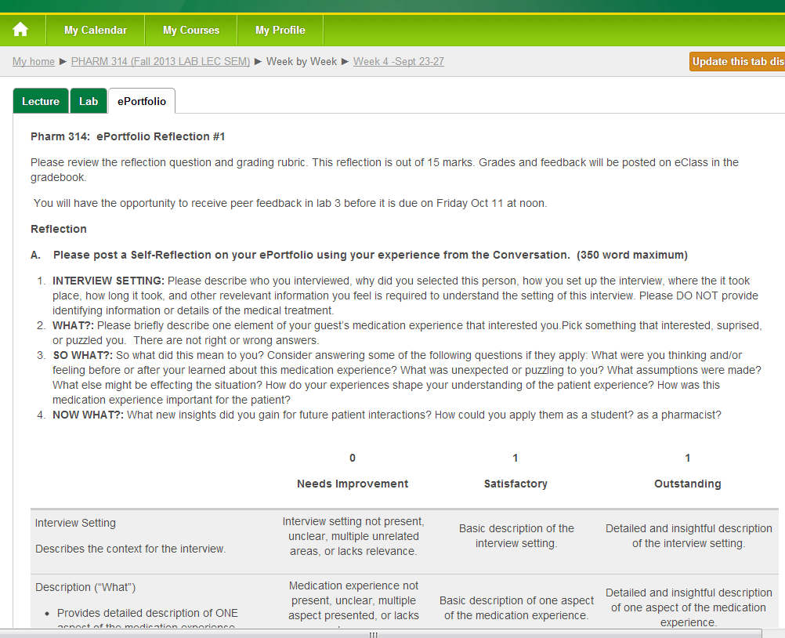

Slide 7
 | 0 Needs Improvement | 1 Satisfactory | 2 Outstanding
Description (“What”) · Provides detailed description of ONE aspect of the medication experience. | Med exp not present, unclear, multiple aspect presented, or lacks relevance. | Basic description of one aspect of the medication experience. | Detailed and insightful description of one aspect of the medication experience.
Context (“So What”) · Meaningful attempt to understand the personal experience -Explores how idea aligns with own beliefs or values · Evaluates how own thoughts, actions, and perceptions may have changed (or not) | Analysis of event context missing, unclear, or lacks relevance. Writing is descriptive. | General analysis of how event has impacted self and aligns with own ideas (or not). Some details may be lacking. | Clear examples of how this experience changed self. Clearly and insightfully analyzes how event has impacted self, and aligns with own ideas (or not). Personalized/ in-depth.
Implications (“What Now”) · Event analyzed with reference to future coursework and future practice. | No relevant implications for future practice identified. | Indicates plans for future based on the reflection. | Specific and insightful future plan.
Writing Style/ Organization · Spelling /capitalization · Sentence structure · First person encouraged · No informal word or contraction · Transitions, sequencing, flow · Concise · Meets Deadlines | Significant errors. Colloquial tone and language. Inadequate proof reading. NOT Submitted to eClass by due date and NOT available in the ePortfolio. | Few grammatical, spelling or organizational errors Submitted to eClass by due date and available in the ePortfolio. | Essentially error free. Reads well. Submitted to eClass by due date and available in the ePortfolio.

Slide 8
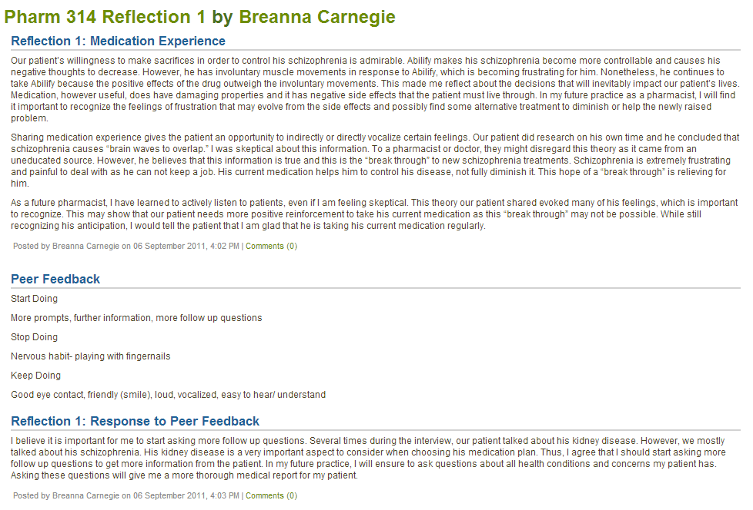

Slide 9
In Pharmacy Practice Lab
Peer Feedback on Simulation
Start doing
Stop doing
Keep doing
Feedback is Clear, Owned, Regular, Balanced, & Specific
Simulation
Next Simulation
Online ePortfolio
Self Reflection:
What? (While you may list several aspects; clearly focus on 1)
So What? (why is it important)
What Now? with SMART* Goal(s)
Record peer feedback and reflect:
What? (focus on 1 key area)
So What?
What Now? with SMART* Goal(s)
*Specific, Measureable, Attainable, Realistic, and Timely

Slide 10
