Slide 1
Applied Land Use Planning
Curriculum Design Process
Erika Smith, PhD Candidate
Senior Instructional Designer
Learning Engagement Office

Slide 2
Objective
Discuss the process, pedagogies and principles informing recent online course design and delivery in ALUP

Slide 3
Overarching Process & Support
Learning Engagement Office
Our team provides learning design and delivery support throughout the instructional development process and course life-cycle for online, blended, and face-to-face courses.

Slide 4
Curriculum Design
Iterative process:
Needs Analysis
surveys, planning, University approvals
Instructional Design
program wide & course specific
Develop & Implement Curriculum
training and development of instructors
Evaluation
analysis of pilot data

Slide 5
Instructional Design Process
Collaboration of:
Instructional Designer
Academic Advisor
Subject Matter Experts
External Reviewers
Editor
Program administrators
E-Learning Specialist

Slide 6
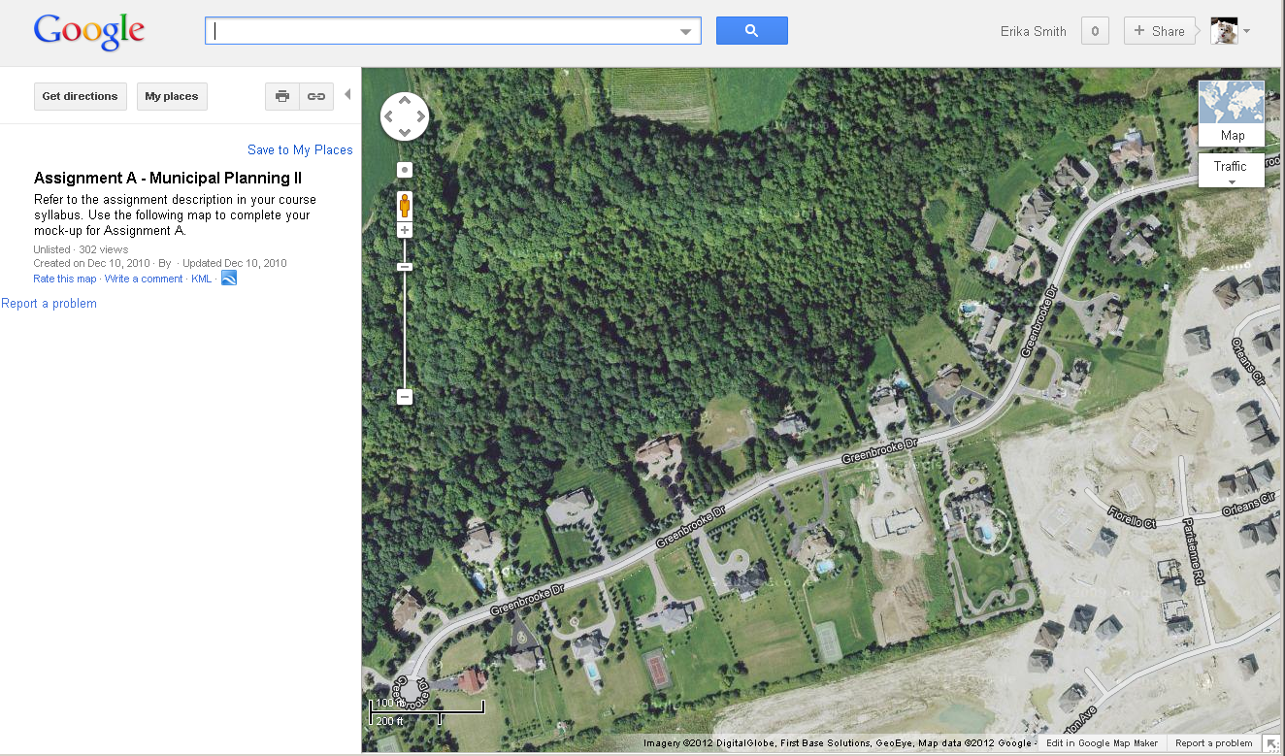
Municipal Planning II
39-hours, online

Slide 7
Urban Environments
21-hours, face-to-face

Slide 8
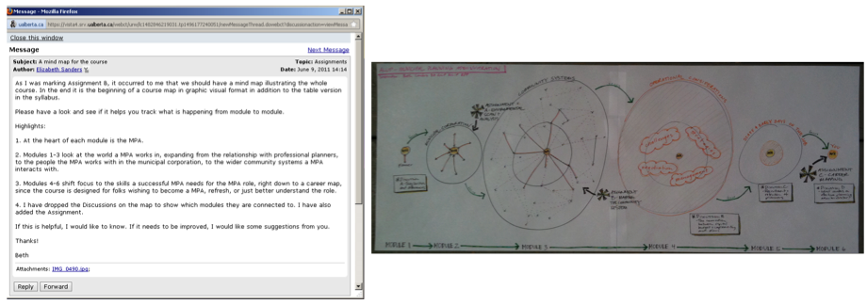
Municipal Planning Management
39-hours, online

Slide 9
2 Online Courses Approved For-Credit
Course Innovations:
Rural Environments (Spring 2014)
Regional Planning (Winter 2014)
Both will accepted for credit in the new BSc/BA in Planning.
Also available in our non-credit professional ALUP certificate.

Slide 10
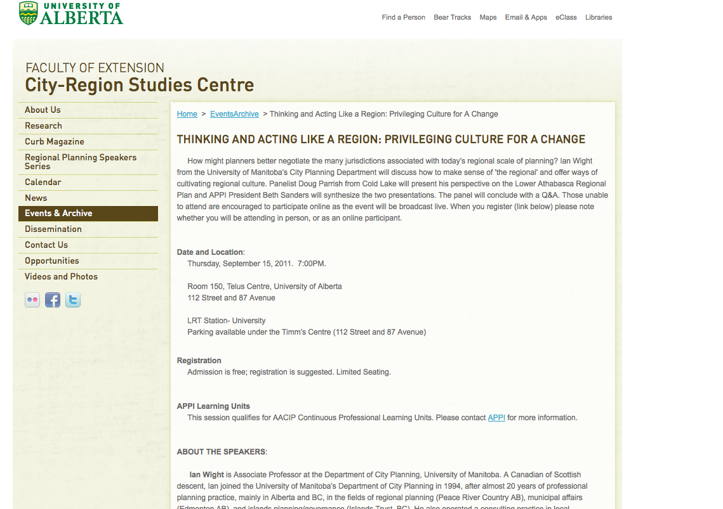
City Region Studies Centre
webinars

Slide 11
Discussion: Comments? Questions?
Erika Smith
Senior Instructional Designer
esmith@ualberta.ca

