Slide 1
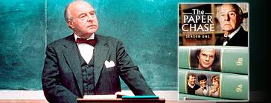
Creating Safe Zones for Student Engagement: Lessons from the Law School
Bruce Ziff
CTL Symposium
August 2014

Slide 2
Exercise
Please write down, in a sentence or two, the most memorable positive classroom experience you had as a student.
I will not ask you to read out your answer.

Slide 3
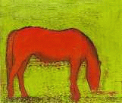
Drumheller Foal Problem
In a field somewhere outside of Drumheller, Alberta, a foal is born. In this way, a new being has come into the world. This is all that you know about the situation.
Who, if anyone, owns the foal? Outline ALL of the plausible ownership rules one might develop to govern the answer to this question.
You have 10 minutes.

Slide 4
For $2.00, reframe the right recognised by the Court, not as “quasi- property”, but as “property” (unmodified).

Slide 5
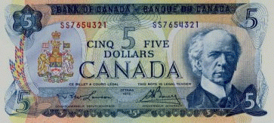
SPECIAL NOTICE
A prize of $5.00 will be awarded for asking the right question during this part of the class.

Slide 6
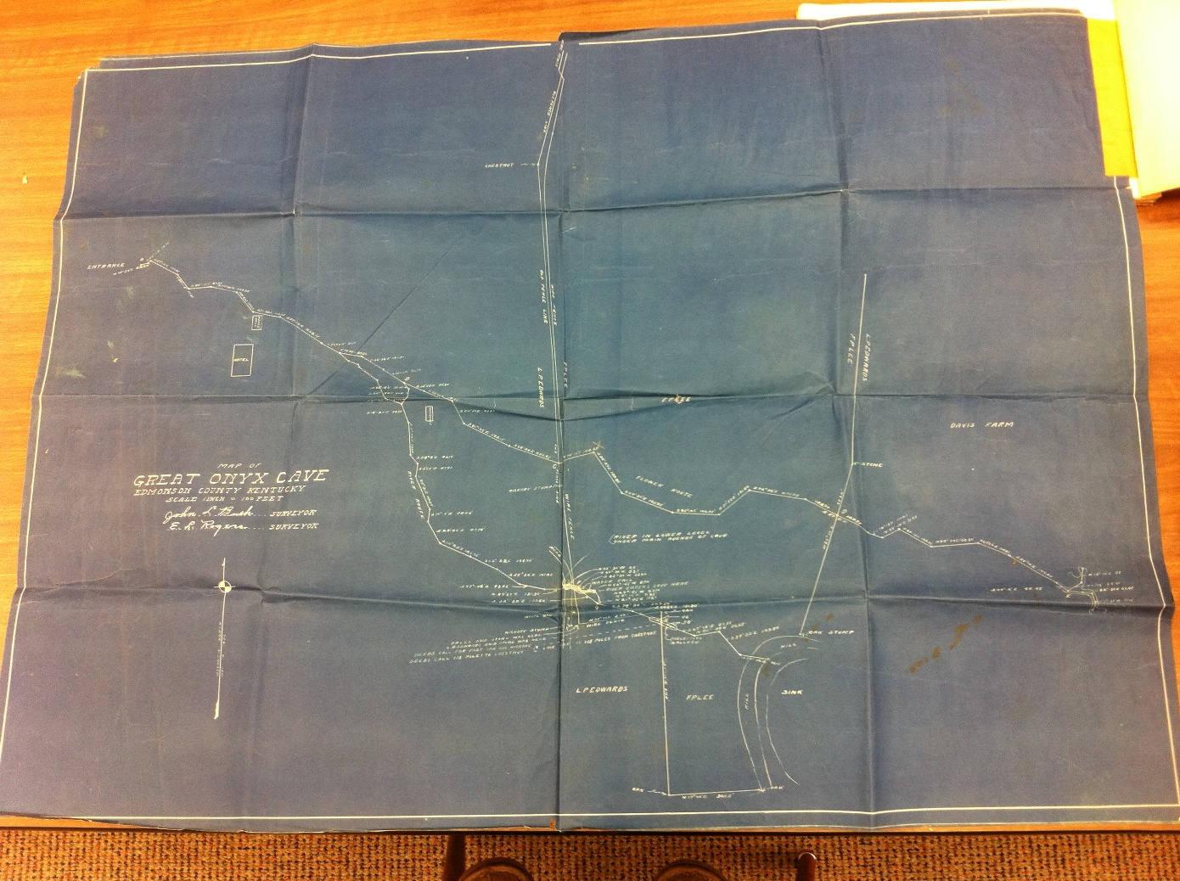

Slide 8
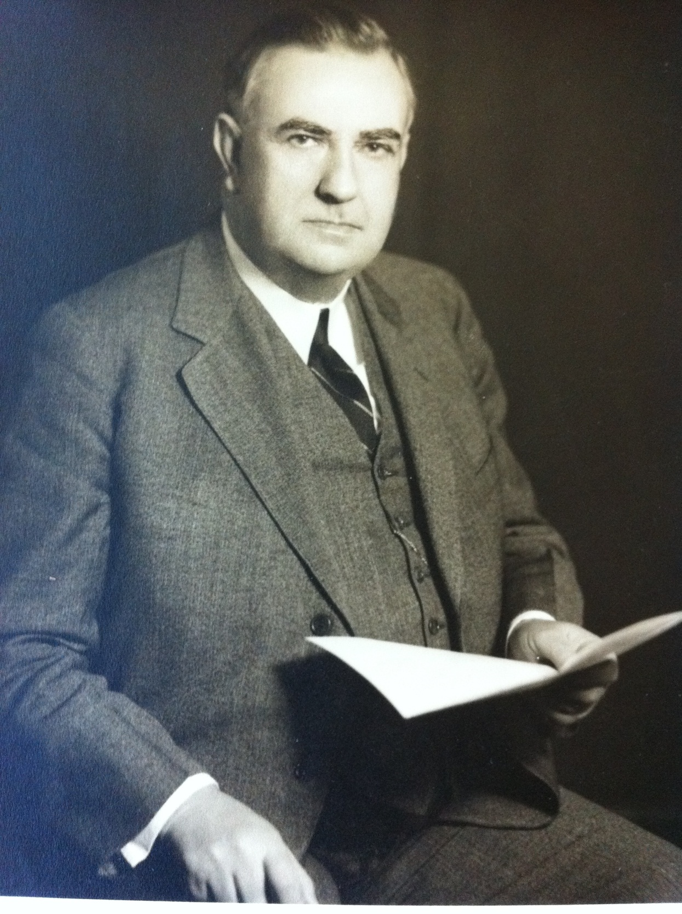

Slide 9
LOGAN’S DISSENT
LP Edwards said Great Onyx Cave all belonged to him.
But Pate Lee sued Edwards for a share.
Judge Porter Sims permitted Lee to map the avenues,
The appeal court held that this was right and fair.
Mills Logan disagreed with his brethren on the bench;
A passionate dissent lays out his view.
Edwards found this black abyss, and through labour made it his.
Title to Great Onyx Cave was his due.

Slide 10
Chorus
They risked their lives, just like Floyd Collins,
And found fairyland below.
Fighting their way through the stygian darkness,
By the flickering flare ... of their flaming flambeaux.

Slide 11
People came from far and wide to see this wondrous world,
Through the entrance that Edwards had found.
He knew nothing, and cared less, who held the surface rights.
Edwards owned the sparkling chambers underground.
The horse leach's daughters, and the surface men
Cried "Give me, Give me", in the name of greed.
This cave is part ours, though they could only guess,
I must dissent, Pate Lee should not succeed.

Slide 12
Chorus
They risked their lives, just like Floyd Collins,
And found fairyland below.
Fighting their way through the stygian darkness,
By the flickering flare ... of their flaming flambeaux.

