Slide 1
The Idea Factory
An exercise to engage undergraduate students
in self-directed learning
David Stuart Department of Biochemistry

Slide 2
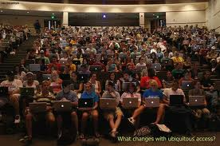
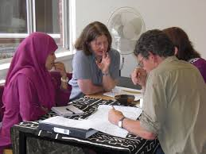
My Teaching
Biochem 200
Introductory Biochemistry
(200-500 students)
Bioch 450/450
Virology
Bioch 425/525
Proteomics
(20 – 60 students)
Biochem 630
Molecular Biology
(3 students)
Lectures
assignments
Read and interpret papers
Discussion and presentation
of literature

Slide 3
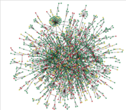
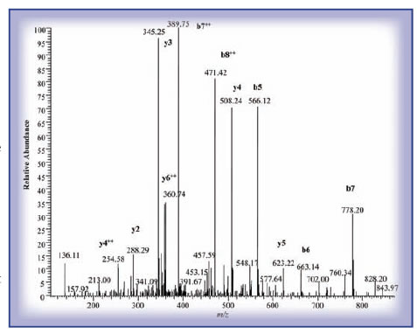
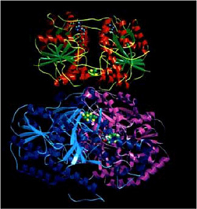
Biochem 425/525
Proteomics
About 20 students, mix of graduate and undergraduate
Large scale study of proteins in cell, their structures,
functions and how they interact with one another.

Slide 4
Evolving Bioch 425 with elements of “flipping”
Teaching with more than didactic lectures

Slide 5
Create a focus on self-directed learning
“In its broadest meaning, ’self-directed learning’ describes a process by which individuals take the initiative, with or without the assistance, in diagnosing their learning needs, formulating learning goals, identify resources for learning, choosing and implement appropriate learning strategies, and evaluating learning outcomes.” (Knowles, 1975, p. 18)

Slide 6
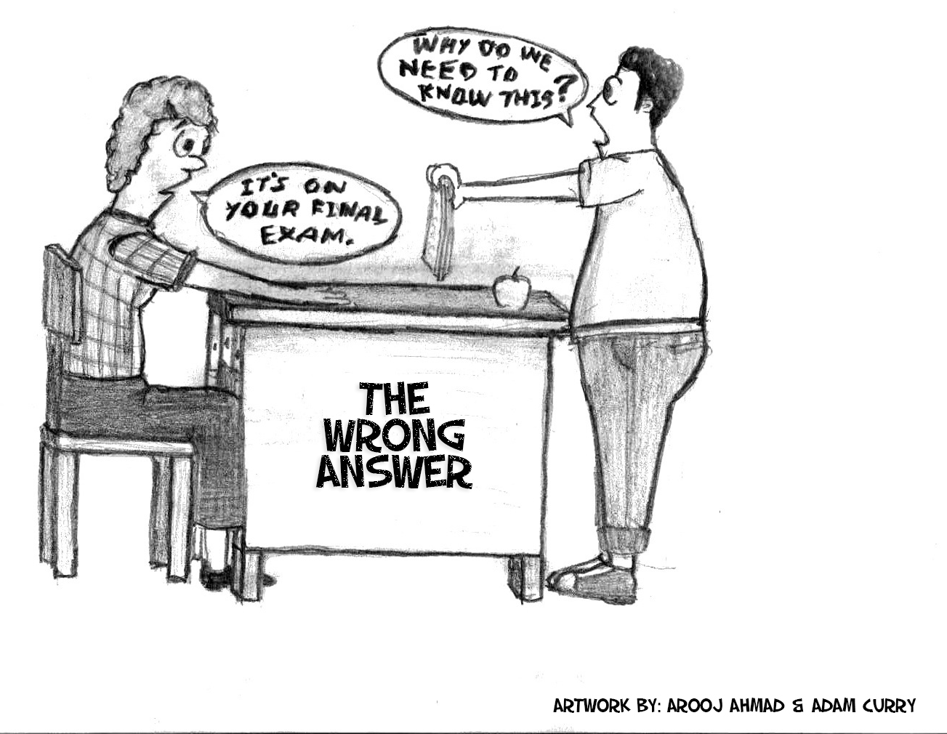
Why employ self-directed learning
A valuable way to teach students how to learn.
Transferrable learning skills.
- A sense of control over learning results in greater acquisition of materials.
- Allows students to explore the available resources and discover others.

Slide 7
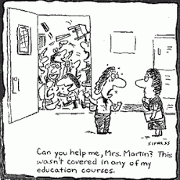
Self-directed learning provides choices
“Everybody is a genius. But if you judge a fish by its ability to climb
a tree, it will live its whole life believing that it is stupid.”
- Albert Einstein
and adaptability

Slide 8
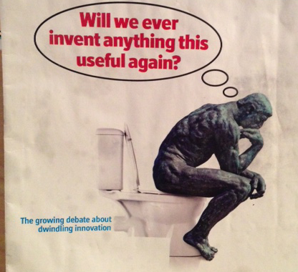
Self-directed learning promotes
creativity and innovation
Educating students in how to learn creates the ability for life long learning.
This also takes advantage of natural curiosity.
Allows students to exercise their creativity.

Slide 9
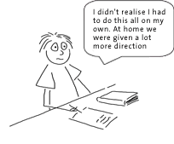
The idea factory project
Structured self-directed learning SSDL
Identify a problem that can be solved or investigated with proteomics.
Present the problem and your solutions to a panel of judges and the class.
Convince the panel that your problem is worthy of investigation and that
they should fund you to investigate it.
Preparation: students are given a lecture and assignment on how
to read scientific papers.

Slide 10
The Idea Factory Process
Class divides into teams of 4
Each team identifies a problem
Team presents their problem
and solution
Team develops a solution

Slide 11
The “Dragons Den”
Teams present to a panel of four evaluators
(Departmental Chair, CEO Alberta Innovates) and the class.
They must “sell” their idea to the evaluators as if seeking funding from the panel.
10 minutes presentation
5 minutes critique
Questions from panel and class

Slide 12
In the Dragons Den
When the students arrive for their presentation each team
is divided into presenters and critics
Critics
Presenters
Presenters: Present the proposal.
Critics: Outline limitations of the proposal.

Slide 13
Evaluation of student performance
Student performance criteria
The team displayed a clear understanding of the research problem
and methods.
- A convincing case was made for the importance of the problem.
- The proposed methods were appropriate for the problem.
- Creativity/innovation was displayed in the methods and analysis.
- The project as presented was feasible.
Valuable results (knowledge, IP, data bases) would result from this
investigation.
- The team indicated how the work could implemented.
- The presentation was well organized and coherent.
- The team answered questions effectively.
- The critics effectively identified limitations of the proposal.

Slide 14
Measuring outcomes
What do the students think?
I learned more about the topic than I would have through a lecture.
96.3% strongly agree, n = 54
The exercise increased my understanding of proteomic technologies
and applications. 98.1% strongly agree n = 54
I gained presentation skills. 85.2% strongly agree n = 54
I had the opportunity to exercise creativity. 83.3% strongly agree n = 54
The exercise provided understanding that did or could transfer
to other research projects. 92.6% strongly agree n = 54

Slide 15
What the students did not like
Uncertainty
11% of students would have liked to know before hand
whether they would present or critique their proposals.
How much should this influence the education process?
Should we only do what the students like and feel that they benefit from?

