Slide 1
Supporting and Assess Team Skills
Paula Marentette, Augustana Campus, UofA

Slide 2
Operant Conditioning
 | pleasant | unpleasant
positive: adding something | positive reinforcement (giving praise) | positive punishment (spanking)
negative: removing something | negative punishment (grounding) | negative reinforcement (avoiding nagging)
Reinforcement ALWAYS increases behaviour. Punishment ALWAYS decreases behaviour.

Slide 3
Operant Conditioning
 | pleasant | unpleasant
positive: adding something | positive reinforcement (giving praise) | positive punishment (spanking)
negative: removing something | negative punishment (grounding) | negative reinforcement (avoiding nagging)
wrecking your car due to speeding?
scratching a mosquito bite for itch relief?

Slide 4
Team Based Learning
individual quiz
team
quiz
application exercises
lecture on complex concepts

Slide 5
Comprehensive Assessment of Team Member Effectiveness (CATME) Loughry et al. (2007)
Contributing to the team’s work
Interacting with teammates
Keeping the team on track
Expecting quality
Having relevant knowledge skills and ability

Slide 6
VALUE Rubric, Rhodes (2010)
Contributes to team meetings
Facilitates the contribution of team members
Individual contributions outside of team meetings
Fosters constructive team climate
Responds to conflict

Slide 7
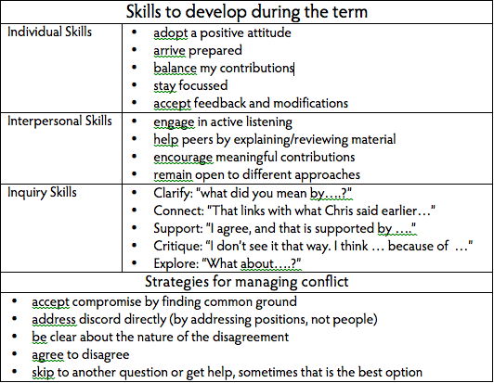
Team Skills Framework

Slide 8
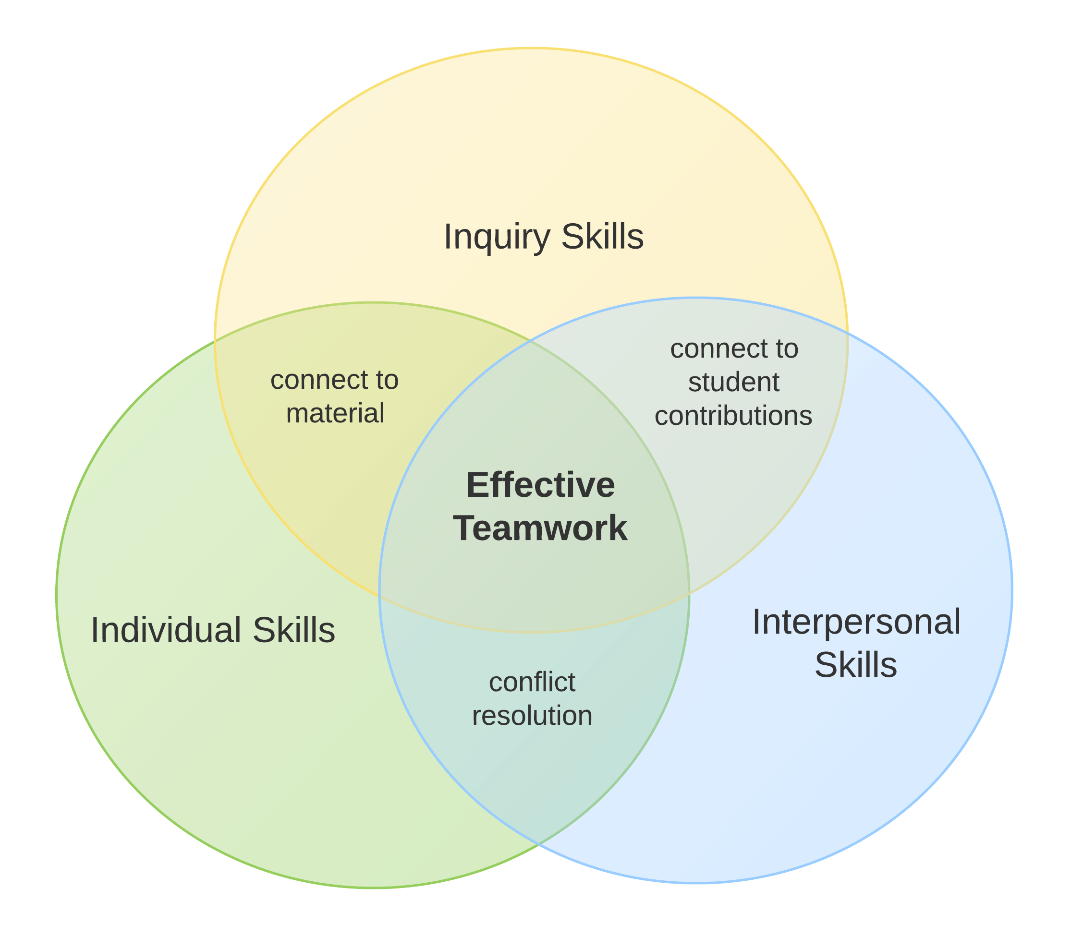
Team Skills Framework

Slide 9
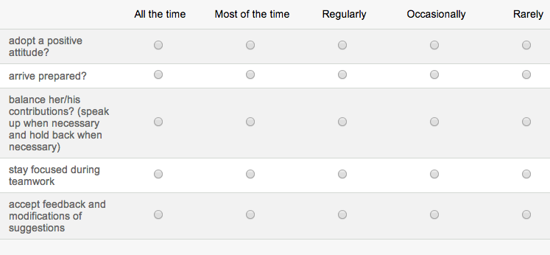
Self and Peer Assessment

Slide 10
Results – Individual Skills

Slide 11
Results – Interpersonal Skills

Slide 12
Results – Inquiry Skills

Slide 13
Acknowledgements
McCalla Professorship, Office of the Provost
Alison Owens and Laura Friesen
Augustana Faculty

Slide 14
References
Conference Board of Canada (2000). Employability 2000+. http://www.conferenceboard.ca/topics/education/learning tools/employability-skills.aspx
Hughes, R. L., & Jones, S. K. (2011). Developing and assessing college student teamwork skills. In J. Penn (Ed.), Assessing complex general education student learning outcomes. New Directions for Institutional Research, 149. San Francisco, CA: Jossey-Bass.
Loughry, M.L., Ohland, M. W., & Moore, D. D. (2007). A theory-based assessment of team member effectiveness. Educational and Psychological Measurement, 67, 505-524.
Marentette, P., Owens, A., & Friesen, L. (2013, May 23). Improving teamwork: The team skills framework. Poster presented at the Association for Psychological Science-Society for the Teaching of Psychology Teaching Institute, Washington, DC.
Michaelsen, L. K., Knight, A. B., & Fink, L. D. (2004). Team-based learning: A transformative use of small groups in college teaching. Sterling, VA: Stylus Publishing.
Rhodes, T. L. (Ed.). (2010). Teamwork VALUE rubric. In Assessing outcomes and improving achievement: Tips and tools for using rubrics. Washington, DC: Association of American Colleges and Universities.
Sweet, M. & Michaelsen, L. K. (2012). Team-based learning in the social sciences and humanities. Sterling, VA: Stylus Publishing.
Walvoord, B., & Anderson, V. J. (2010). Effective grading: A tool for learning and assessment in college, 2nd ed. San Francisco, CA: Jossey-Bass.

