Slide 1
Affordable housing and homelessness in alberta: some considerations
Presentation by Nick Falvo
24 Oct 2024
3rd Annual City Building Conference
University of Alberta School of Business and the City Building Centre

Slide 2
Why community (i.e., social) housing?
Lack of alignment between rents and incomes at the low end of the market.
High-growth areas of urban areas tend not to create low-cost rental housing.
Great long-term investment (rents stay low over the long term).

Slide 3
Community housing (cont’d)
Historically, and relative to other OECD countries, Canadian governments have underinvested in housing for low-income renters.
On a per capita basis, Canada as a whole now has roughly half as much community housing (i.e., social housing) stock as the average OECD country.

Slide 4
Community housing (cont’d)
Community housing units per 1,000 people
Saskatchewan | 36
Manitoba | 32
Nova Scotia | 30
New Brunswick | 28
Newfoundland and Labrador | 23
Ontario | 22
British Columbia | 22
Prince Edward Island | 22
Quebec | 22
Alberta | 20
Notes:
Source. Deloitte. (2023). The impact of community housing on productivity.
https://chra-achru.ca/wp-content/uploads/2023/11/Community-Housing-and-Productivity-Study_final.pdf
Original data source. Statistics Canada (based on 2023 Q2 data)

Slide 5
Homelessness
On a nightly basis, Calgary and Edmonton each sees approximately 1,000 persons sleeping in one of several emergency shelters.

Slide 6
Drawbacks of shelters
Overcrowding
Poor food quality
Inadequate hygiene facilities
Lack of privacy
Bed bugs and body lice
High rates of disease transmission
Sleep deprivation
Inadequate harm reduction services
Theft and assault

Slide 7
Drawbacks of shelters (cont’d)
Very challenging for couples to stay together.
Shelters typically do an inadequate job of creating safe ‘gender neutral’ spaces.
Most shelters do not allow pets.
Most have little if any storage capacity.

Slide 8
Rough sleeping
Those drawbacks often prompt persons to sleep outside as an alternative.
When persons sleep outside, they face exposure to extreme weather, physical and sexual violence, property theft, and risk of fire and flooding.

Slide 9
Lack of daytime options
A recent report by Vibrant Communities Calgary found that persons experiencing homelessness often spend time on public transit because they have nowhere else to go during the day.
It also found that some people experiencing homelessness use illicit substances on public transit because they deem it safer to overdose there than in most other locations.

Slide 10
UCP on homelessness
In Oct 2022, the UCP government of Jason Kenney announced $63M over 2 yrs in new homelessness funding.
Referred to as the Action Plan on Homelessness, this new funding consisted of: equalizing $ between YEG & YYC; more emergency shelter spaces during winter months; the conversion of all provincially-funded emergency shelters to ‘24-7 access;’ the piloting a new Service Hub Model at emergency shelters in YEG and YYC.

Slide 11
UCP on homelessness (cont’d)
2023 provincial budget announced new $ for homelessness responses, including for emergency shelters.
The additional $ has also supported new ‘women only’ shelter spaces as well as new Indigenous specific shelter spaces. It’s also supported Edmonton’s new ‘navigation and support centre’ for people impacted by encampment closures.

Slide 12
UCP on homelessness (cont’d)
Budget 2024 announced $24.6 million for homeless shelters, a 29% increase from Budget 2023

Slide 13
Provincial Navigation Centres
Provincially-led Navigation and Support Centre (NSC) opened in Edmonton in January 2024.
Part of partnership between GoA and Edmonton Police to close encampments—a person ‘evicted’ from an encampment can go to the NSC as a first step toward other supports.

Slide 14
Provincial Navigation Centres (cont’d)
Edmonton’s NSC provides short-term supports and referrals related to:
Income assistance and employment supports
ID
Emergency shelter (including assistance with transportation to an emergency shelter)
Health care (including addictions treatment)
Animal rescue services to put pets into temporary foster care
Indigenous supports (i.e., connections to cultural supports)

Slide 15
Provincial Navigation Centres (cont’d)
People can stay there with their pet until a suitable home is found for the pet.
A second location in Calgary opened in July 2024.

Slide 16
OSSI funding
In spite of the rising cost of rent across the province, OSSI funding has been flatlined at pre-pandemic levels (exception: top up received by Edmonton to ‘level playing field’ with Calgary—this was mentioned on Slide #10).
Much OSSI $ supports vulnerable tenants in private market housing—i.e., units owned by private landlords who charge whatever rent levels the market can bear.
Ergo: Communities in receipt of OSSI funding have had to support fewer tenants via Housing First each year.

Slide 17
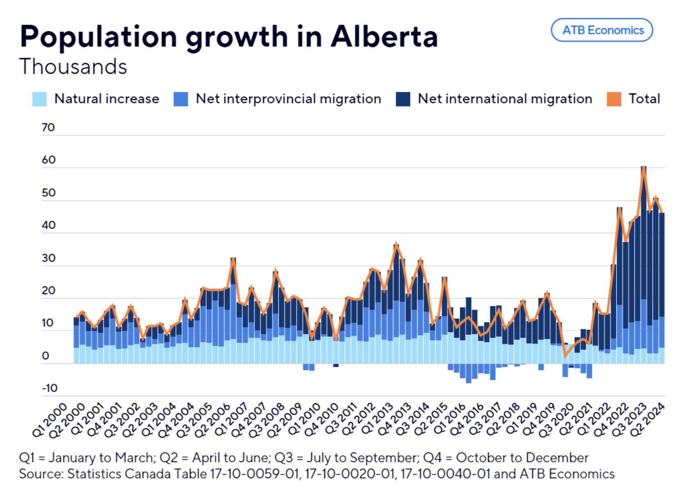
Population growth
Notes:
Source: https://hello.atb.com/the-twenty-four-alberta-bound-continues-province-leads-in-population-growth

Slide 18
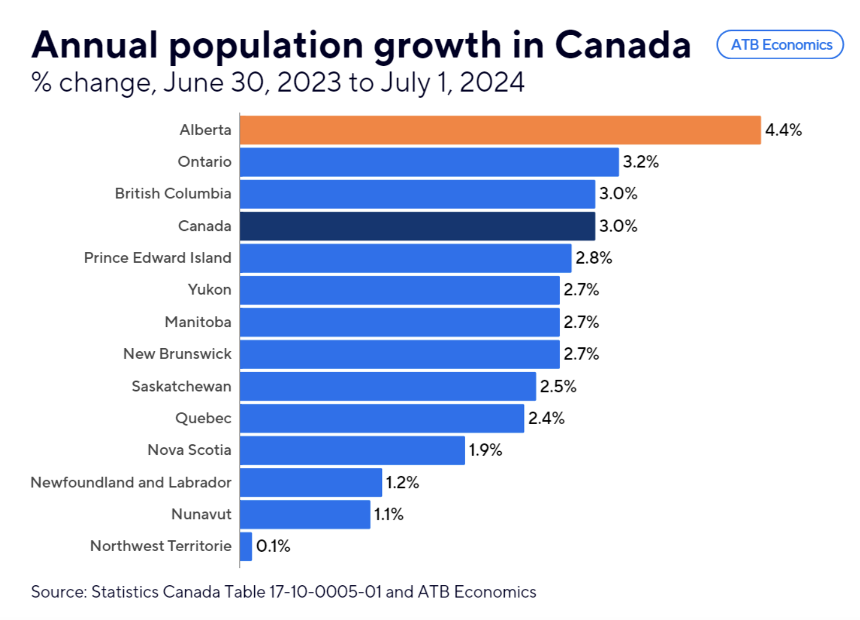
Population growth (cont’d)
Notes:
Source: https://hello.atb.com/the-seven-september-27-2024

Slide 19
Low vacancy rates
City | Rate
Calgary | 1.4%
Edmonton | 2.3%
Grand Prairie | 1.5%
Lethbridge | 2.3%
Medicine Hat | 1.1%
Red Deer | 0.9%
Wood Buffalo | 8.8%
Notes:
Source: CMHC Housing Market Information Portal. Data is from Oct 2023.

Slide 20
What’s needed?
Review operating agreements (+ OSSI funding)
Funding repair and retrofitting of existing community housing units
Fund operating costs for newly-created supportive housing units for vulnerable subpopulations
Enhance Indigenous-specific operating funding for service providers

Slide 21
What’s needed (cont’d)?
Enhance eviction prevention initiatives
Review rent regulation

Slide 22
Thank you

