Slide 1
Misconceptions in the Chemistry Laboratory
10th Harris Teaching Workshop
May 24th, 2012
Erika Smith
Norman Gee
Amira Elyazbe
Frances Sutherland
Ross Witherell
Wayne Lippa
Lydia Chen
Lucio Gelmini

Slide 2
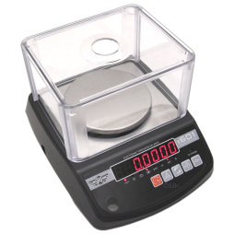
TAKING MEASUREMENTS
Digital measurement - no error!
Glassware – markings 100% exact

Slide 3
THAT WHAT IT SAID
Always need exact amounts
Got to start at zero

Slide 4
LABS IN GENERAL
Nothing works even though I followed the procedures.
Because the instrument says “this”, results has to be “right”. (Not sure why there is a difference between my result and theory)
Science labs have no error-should be able to get right answer

Slide 5
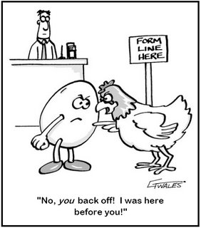
CORRELATION OF LAB & LECTURE
Can’t do lab unless material “covered” in lecture
Labs are completely
“separate” from lecture.
Don’t need previous
knowledge to do lab.

Slide 6
INSTRUCTORS & STUDENTS
Students are expecting the instructor to do all the background information.
Each lab is separate from
the next so I don’t have to
remember what I did before.
Instructor is there to help!
You ‘don’t’ have to be prepared
to do the lab
Ok to copy (we should get same result)

Slide 7
Does this look “blue” to you?
Students often lack the confidence to make their own observation! TA will tell me.
Diverse background.
-wrongly assume same
background of students
Did hands on experiments All demos

Slide 8
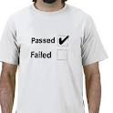
LAB EMPHASIS
Not many marks associated with labs
-not very important
Some schools require
a pass for both lecture and lab portion?

Slide 9
REAL WORLD
No application to what happens in real world
There is always a right answer
Wrong answers don’t tell us
anything
Answer does not always need to make sense – it’s an experiment

Slide 10
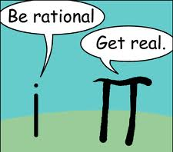
WHAT’S IN A NUMBER?
Infinite sig figs (my calculator made me do it)
If I did it again, I’d get the exact same result

